Slide 1
Beehive Academy Children are Future Scientists

Slide 2
Beehive Academy
Academy for teaching science for children from 5-13 years old
It was established in 2019 in Elmansoura region, Dakahlia governorate
Number of children were 6 child only in each group
In 2020, during corona Quarantine , we developped the methods we use to learn children
We used science communication methods and we believe that spreading science between children in this age is the most important effect on their brain and thinking methodology

Slide 3
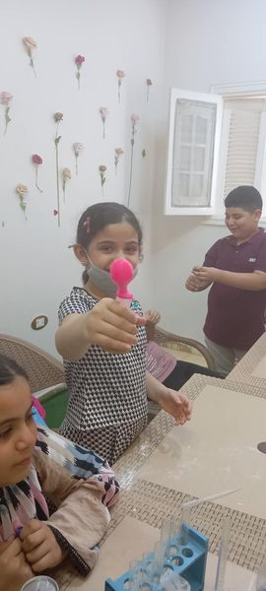
Vision
Each child has the right to learn science,
do experiments and understand different information and also teach it for others in the future

Slide 4
Mission
We are seeking to help all children in Egypt and out to exploit their minds in all fields of science

Slide 5
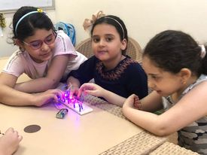
Founders of Beehive Academy
Yasmine allam, microbiologist, faculty of science 2015
Enas tawfiq, chemist ,faculty of science 2009
Moustafa mamdouh, medical physicist, faculty of science 2018
Rawda essam, student at physics department, faculty of science 2022

Slide 6
Aims of beehive academy
Help children to :
think by a creativity way
learn about all fields on science
do experiments themselves
observe, conclude, expect results and write down
A child must learn to understand, not memorize

Slide 7
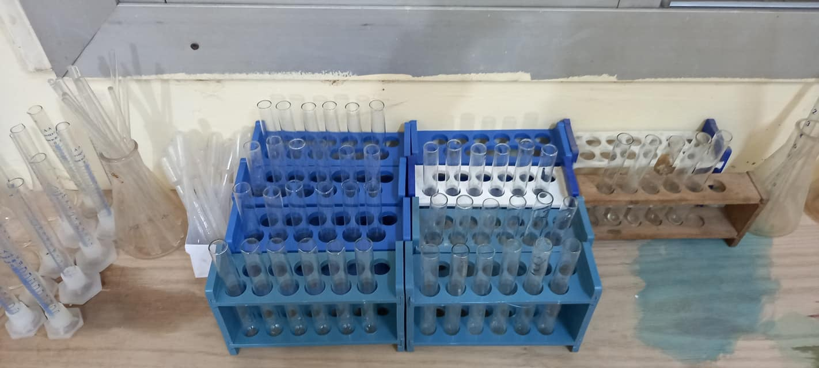
Preparations

Slide 8
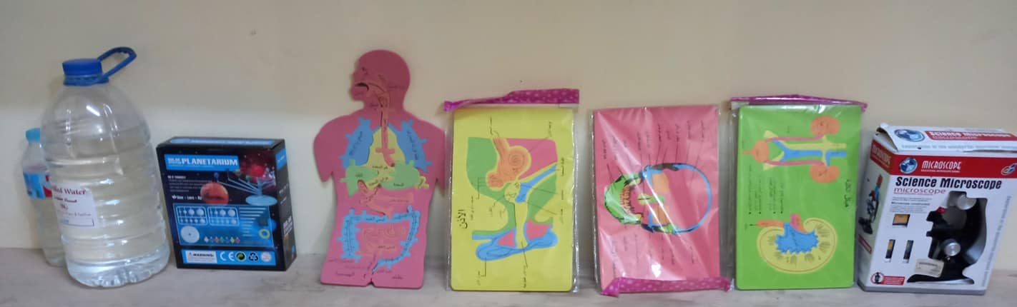
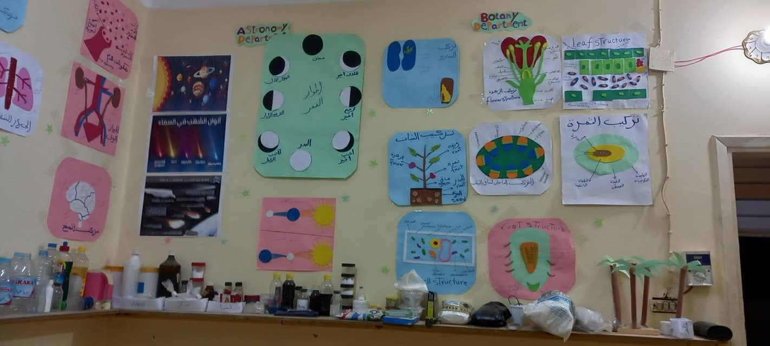

Slide 9
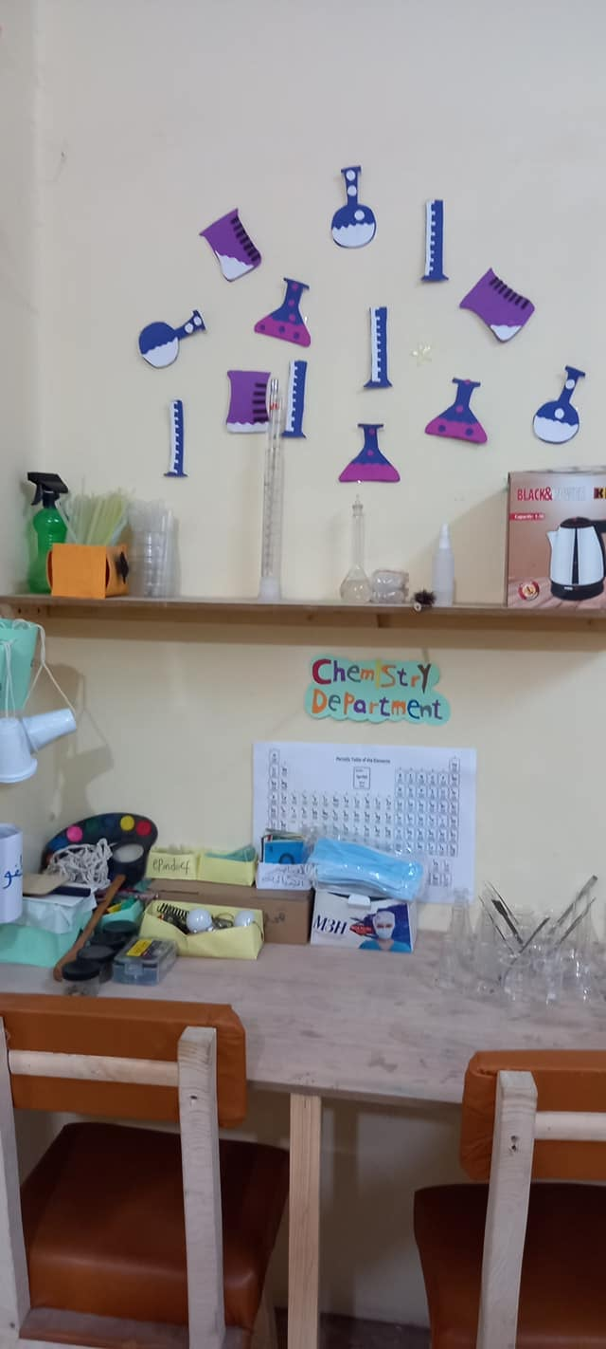
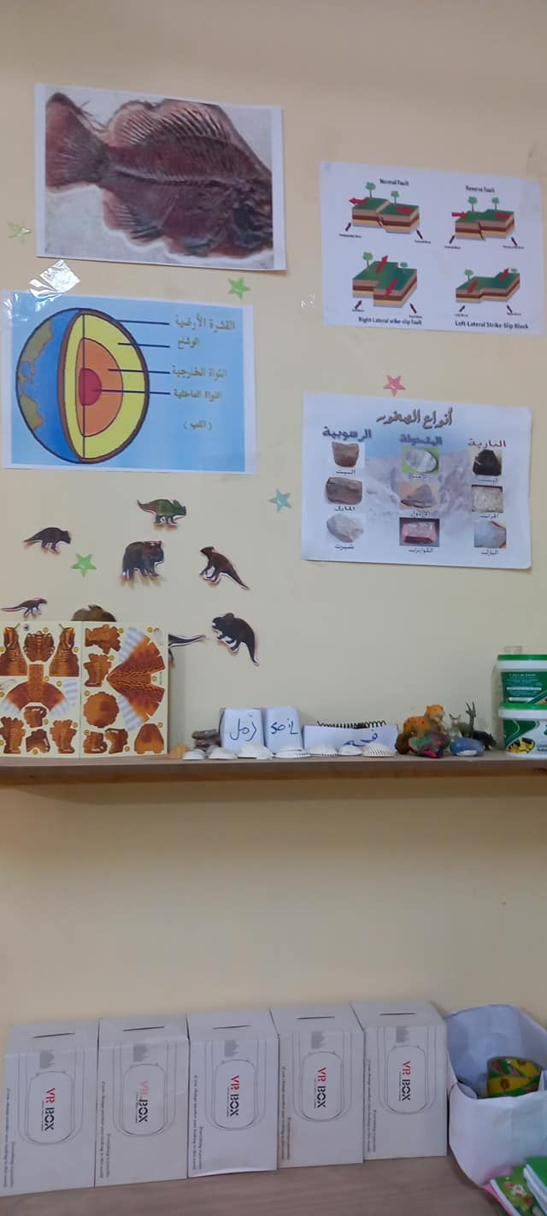
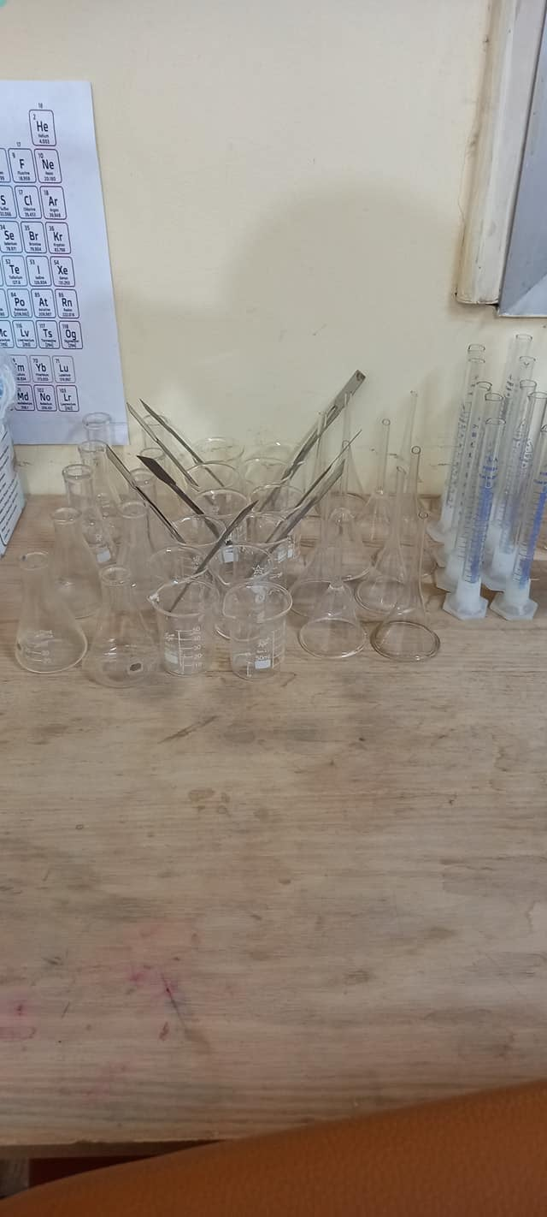

Slide 10
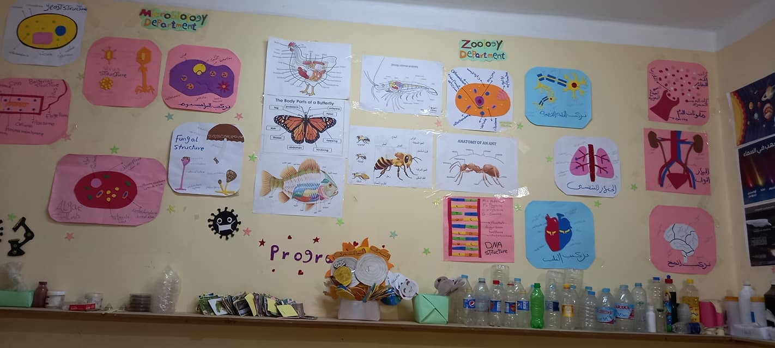

Slide 11
Methods of learning
1- Division children into 3 levels
) 5-7years(is called the young explorer
) 7-9years ( is called the young scientist
)9-13years (is called the young researcher
According to their ability in writting and reading

Slide 12
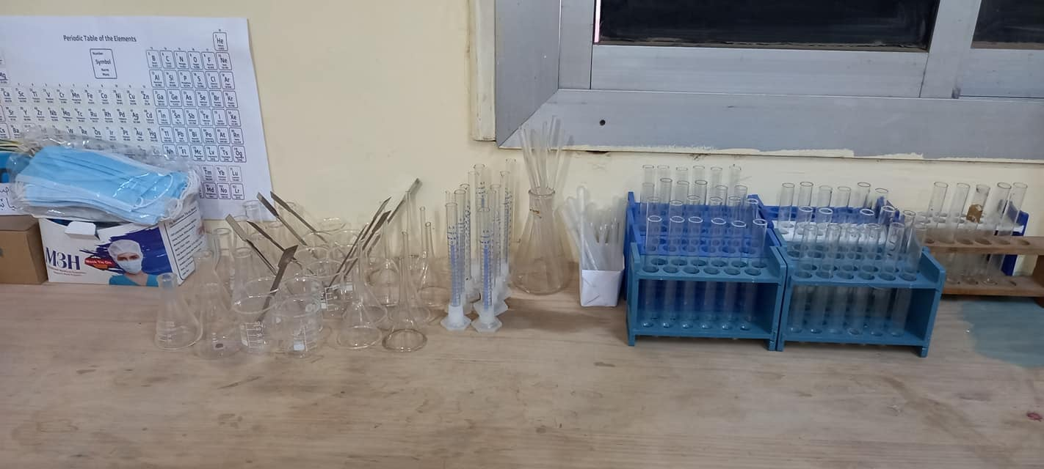
2- each child has his own materials to do experiments himself

Slide 13
Brain storming
3- we depend on brain storming to make children get information by asking them questions
Like
What is the difference between lemon and liquidsoap?
If we want to learn them the differentiation between acid and base

Slide 14
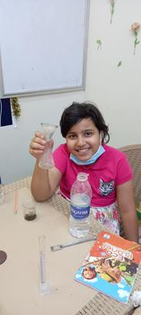
4- We use the simplest tools and methods for the children to reach information

Slide 15
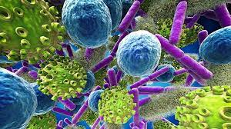
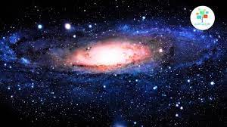
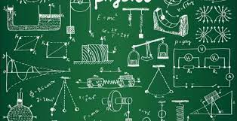
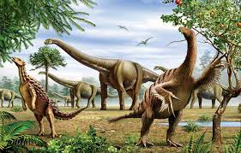
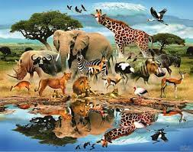
5- Fields of science
Microbiology
Chemistry
Physics
Botany
Zoology
Geology
Astronomy
Robot

Slide 16
Now
Number of children reaches 120 child and they have the ability to be continous in learning
We did more workshops for parents to change their minds towards learning
We developped our curriculum many times according to child's accommodating capacity

Slide 17
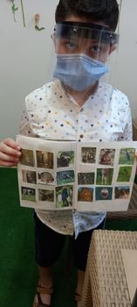
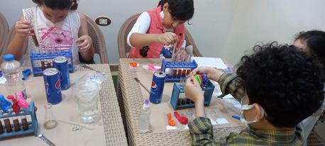
Real photos

Slide 18
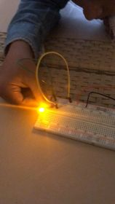
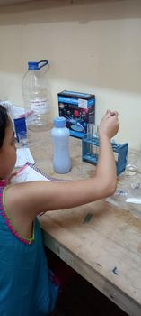
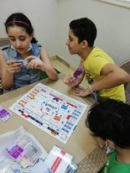
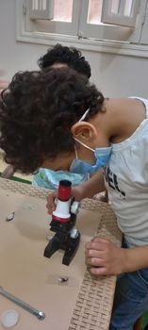

Slide 19
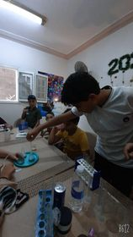
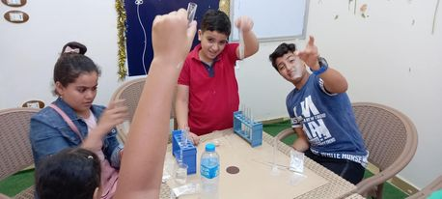
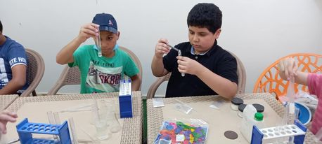
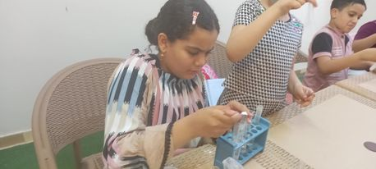
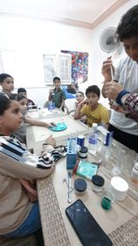

Slide 20
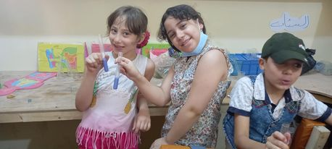
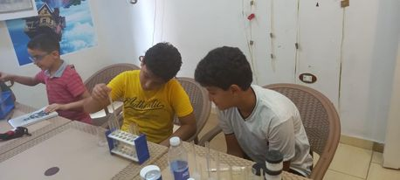
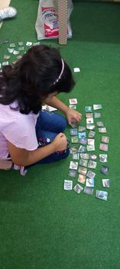
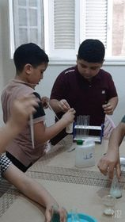
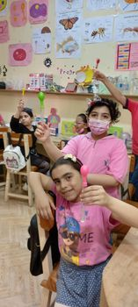
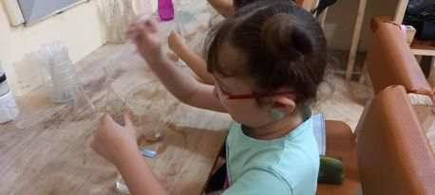

Slide 21
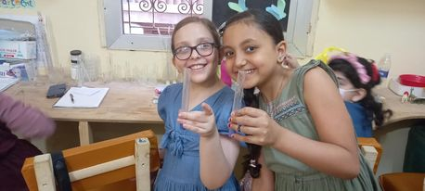
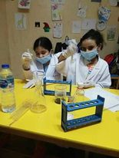
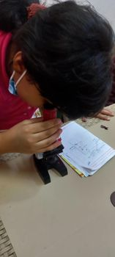
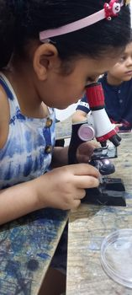
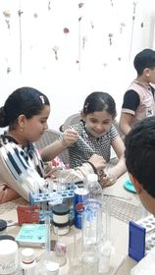
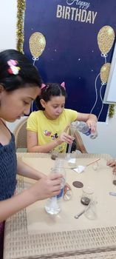

Slide 22
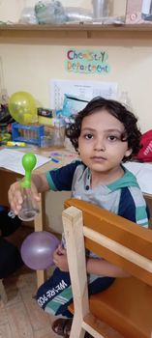
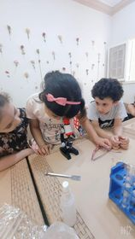
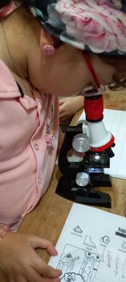

Slide 23
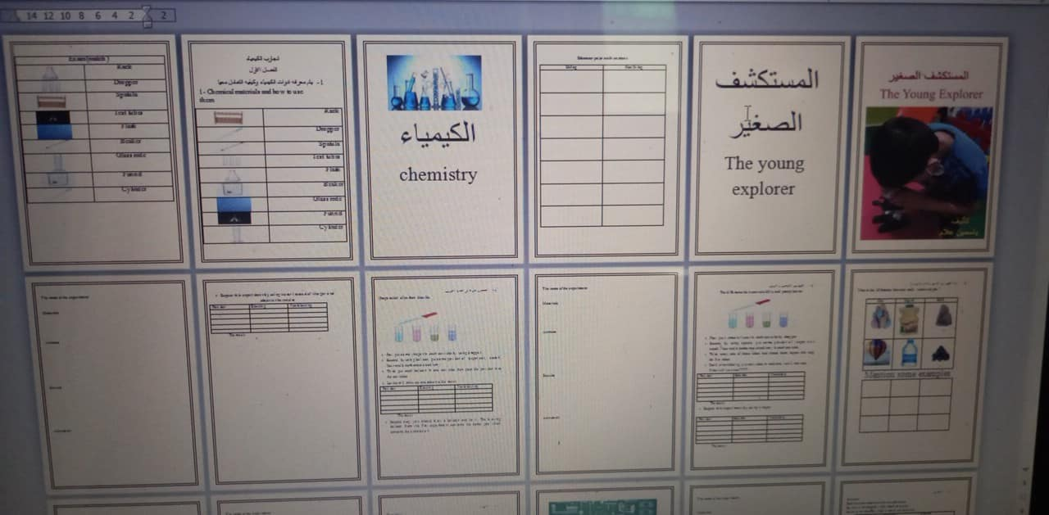
Our curriculum
We look forward to making a new curriculum that enables egyptian children to be genious.

Slide 24
Conclusion and Discussion
We found all children like doing experiments themselves
They enjoy with science when they try to think about the answers of questions
We found that each child has qualifications different from other children
The curriculum should be developped continously
We found that , simple methods can help children get informations

Slide 25
Thanks
contact
Yasmineallam332003@gmail.com
https://www.facebook.com/BeeHive-Academy-605297693277644

