Slide 1
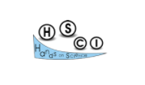


Transferable Methodologies Between In-Class and Online Learning –
A Three Steps Learning Process
The 18th annual international conference on Hands-on Science, HSCI2021
Hands-on Science Education Activities – Challenges and Opportunities of Distant and Online
Petronia-Gabriela Moraru - Technical College ”Edmond Nicolau”
Petrică Moraru – Gymnasium School ”Duiliu Zamfirescu”
Focșani, Romania

Slide 2

Methodology developed under
the Erasmus+ project
SCIENCE CONNECT
(SciCon)
ref.no. 2019-1-RO01-KA201-063169

Slide 3
CONTEXT
1
The work was carried out within the Erasmus + Science Connect project, in order to develop a methodology adaptable to different types of student learning style, including modeling and video analysis.

Slide 4






CONSORTIUM
Seven countries
Latvia
Romania
Portugal
Greece
Turkey
Italy
Spain

Slide 5




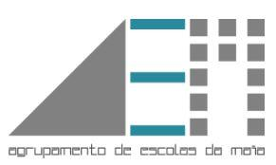

CONSORTIUM
Seven schools
Colegiul Tehnic Edmond Nicolau Focsani - Romania
Agrupamento de Escolas da Maia - Portugal
Daugavpils 13. vidusskola - Latvia
IIS M. Filetico – Italy
20th High School of Thessaloniki – Greece
Sercev Engelsiz Mesleki ve Teknik Anadolu Lisesi – Turkey
AGIFODENT – Spain

Slide 6



CONSORTIUM
Three universities
University of Porto – Portugal
Co-initiator of the Science Connec project
Universita Degli Studi Di Roma La Sapienza –Italy
University ”Dunarea De Jos” Galati – Romania

Slide 7
A special thanks to
Professor Paulo Simeão Carvalho - Assistant Professor at Departamento de Física e Astronomia, Universidade do Porto and Professor Auxiliar at Faculdade de Ciências da Universidade do Porto
The person who taught us how to be creative when we work with students for virtual laboratories, and gave us the tools for that.

Slide 8
MOTIVATION
2
Based on our previous experience in teaching and the work within the Science Connect project, we have identified the main reasons:
  The challenges of the CORONAVIRUS Pandemic - 19 have led to new approaches to education
  The alternation between online, hybrid and in-person classes
  The need to find methods for the study of STEAM, applicable to any of these forms
  The need to develop alternatives for STEAM virtual labs
  The desire to increase the attractiveness of the STEAM study

Slide 9
The challenges of the CORONAVIRUS Pandemic - 19
New methods for STEAM (Science, Technology, Engineering, Art, Mathematics) study
Restrictions caused by the CORONAVIRUS Pandemic have determined the need to quickly find solutions to educational alternatives
The challenges of teaching STEAM, especially physics, require tools and techniques that are not found in other disciplines.
Motivation explained
Increase the attractiveness of the STEAM study
Alternatives for STEAM virtual labs
Existing virtual labs are mostly boring for students, who do not perceive them in connection with reality
The use of previous experience and knowledge, as well as digitization, increase the chances of students accepting the STEAM study, otherwise difficult to accept.

Slide 10
CHALLANGES
3
Interactive simulations, many of them schematic, of relatively simple scientific phenomena or simple devices do not meet the training requirements of students' skills.
These simulations do not facilitate the creativity-based investigation.
They are not adaptable to different learning styles.
It does not help students with learning difficulties to understand the studied phenomena.
It does not study more complex phenomena in their interaction.
They have relatively few values that they can manipulate, compared to real phenomena.

Slide 11

For teachers
Development of active methodologies that effectively involve students in their learning.
Identifying tools that allow connections between previous experience and different STEAM topics.
Implicit demonstration of the contribution that STEAM can have in everyday life.
Help offered to students with learning difficulties.
Adaptability for different learning styles.
Challanges
For students
Identifying the means to build one's own knowledge
Development of own learning processes, useful in the perspective of LLL
Transition from a passive student to an active one and responsible for his own education.
Changing the role of the student, in the main actor of the educational process.
Building skills and competencies based on curiosity and creativity.

Slide 12
METHODOLOGY
4
The methodology includes the integration of :
the making of simple devices or phenomena
their video recording in motion
the analysis of recordings, based on the use of Tracker software
transferability between in-classroom learning, online education, and hybrid learning

Slide 13
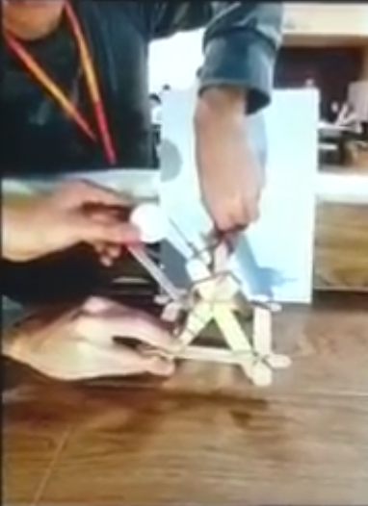
INTEGRATED METHODOLOGY APPLIED
A first integrated methodology was developed for the ballistic study of the catapult, for the rediscovery of the laws of kinematics, basic principles of dynamics and the development of media and IT skills.

Slide 14
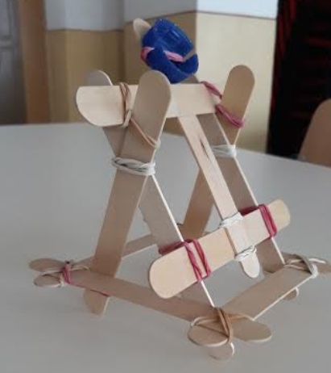
HOW WE WORKED
PRACTICAL
Students are asked to build a device / mechanism, giving them a video trigger or an image.
The model works based on the phenomenon / phenomena that we want students to study
DIGITAL
After a preliminary training, in which students are trained to use Algodoo software, they are asked to create a digital version of the model created practically
Video analyses
Using the Tracker software, students analyze the video recordings of the operation of the two previously created models

Slide 15
Transferability advices
FOR PRACTICAL ACTIVITIES
For both classroom and online education, teachers can present to their students a collection of video recordings of real, animated, or virtual models of the device they will later have to build.
. If limited resources can be used in the classroom for students who are online, they may be asked to find different materials available at home.
In order to stimulate creativity, a contest can be set up to appreciate the functionality as well as the diversity of the materials used and the technical solutions, giving equal chances for all students, no matter what type of learning they attend.
Students can be encouraged to create devices that are not only functional but also artistically decorated to match the purpose for which they are built.
The process of making the devices becomes fun, the boring activity, for students, being eliminated or diminished. Students turn their interest to STEAM Study, with some creative impulses

Slide 16
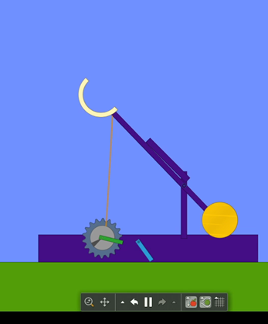
Transferability advices
FOR DIGITAL ACTIVITIES
In cooperation with the ICT teacher, the physics teacher can create video tutorials as well as text tutorials to be made available to students. These tutorials will be adapted for asynchronous learning so as to give students the opportunity to use them at their own pace.
A series of activities can be organized prior to the main activity, with the aim of learning the working and manipulating tools for the creation of digital applications, for the use of measuring instruments, and also for identifying the possibilities offered by the two applications.
If online students will use Zoom, we can use breakout rooms, for making teams of students work independently, which will present their work after that.

Slide 17
Transferability advices
FOR DIGITAL ACTIVITIES
There are multiple solutions for creating the digital version for the practical layout. The Algodoo application can be used mainly for online or hybrid classes. For face-to-face classes, it can only be used if there are laptops in the lab.
Students are informed that in the evaluation of the activity, creativity and imagination will be appreciated, to the detriment of the ad-litteram reproduction of the presented model.
Students will be asked to modify different parameters of the simulation, as well as to record the different data sets provided by the application.
For graph-motion correlation, it is recommended to record the trace of motion, simultaneously with the graph display in xOy spatial coordinates.

Slide 18
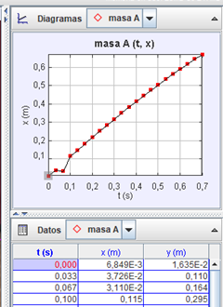
Transferability advices
FOR VIDEO ALALYSES ACTIVITIES
The quality of videos recorded is very important for the results students will get.
Students may be asked to upload videos to a shared folder with their peers.
Comparing student's own recordings with those made by colleagues can reveal to them the qualities for their video recording, the conditions for obtaining them, and possibly determine them to record again their devices or their simulations.
Each video recording on the shared folder is a part of a developing database for the next activities.
At the end of the activity, students will share their results for each video analyze, comparing them. It will be the opportunity to discover the fundamental laws for explaining their device functionality.

Slide 19
TIMELINE OF THE ACTIVITIES
Introduction (based on images and videos)
Introductory study of the software used
Practical activity
Recording videos
Create digital simulation
Video analysis
Conclusions
Main steps for the integrated activities

Slide 20
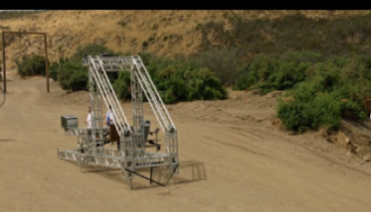
TIMELINE OF THE ACTIVITIES
Introduction (based on images and videos)
Introductory study of the software used
Practical activity
Recording videos
Create digital simulation
Video analysis
Conclusions

Slide 21
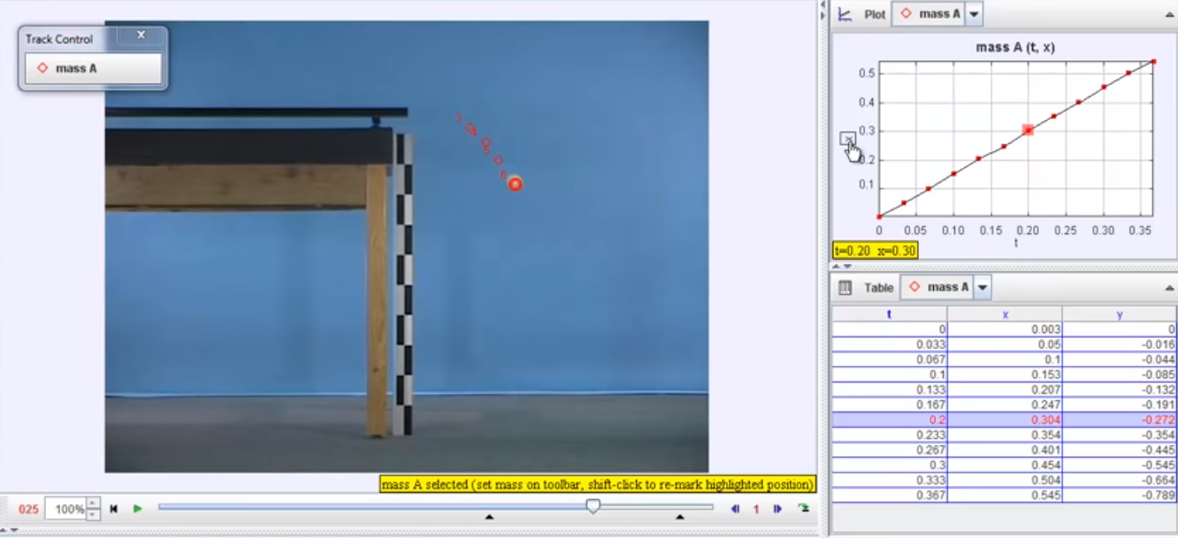
TIMELINE OF THE ACTIVITIES
Introduction (based on images and videos)
Introductory study of the software used
Practical activity
Recording videos
Create digital simulation
Video analysis
Conclusions
first phase of COMPREHENSION and knowledge of the working tools
Algodoo. Screenshot from tutorial made for the project
Tracker – video analyze software.
Screenshot from online learning activity

Slide 22
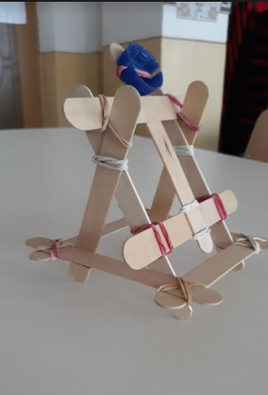
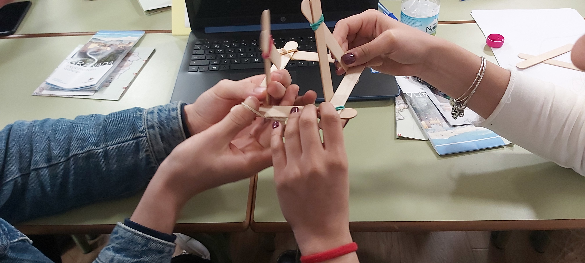
TIMELINE OF THE ACTIVITIES
Introduction (based on images and videos)
Introductory study of the software used
Practical activity
Recording videos
Create digital simulation
Video analysis
Conclusions
Making the model of the catapult.
The catapult mechanism

Slide 23
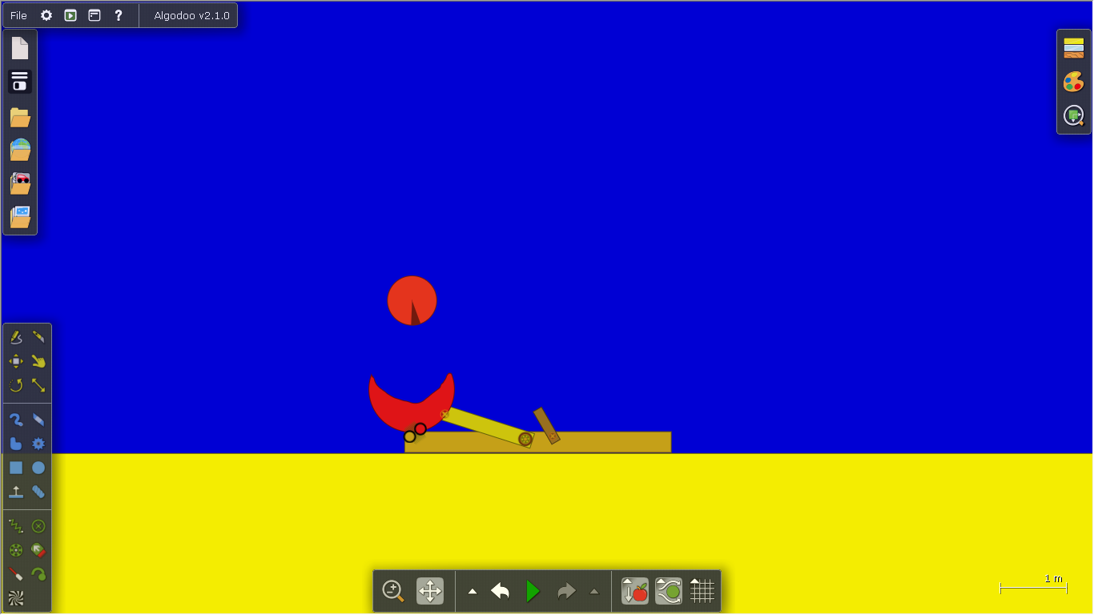

TIMELINE OF THE ACTIVITIES
Introduction (based on images and videos)
Introductory study of the software used
Practical activity
Recording videos
Create digital simulation
Video analysis
Conclusions
Screenshot of a digital model
made by one of our students
Recording of the digital model in action, with the plot and tracer of the projectile

Slide 24
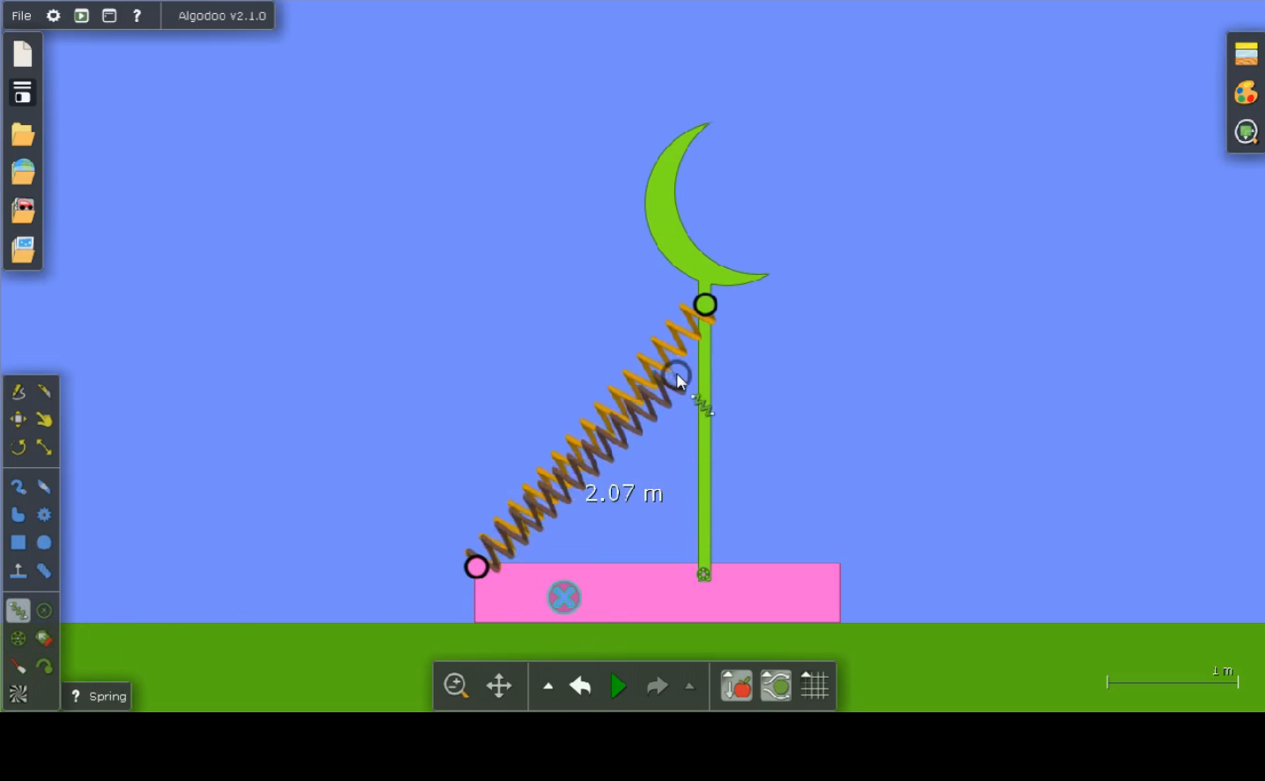
TIMELINE OF THE ACTIVITIES
Introduction (based on images and videos)
Introductory study of the software used
Practical activity
Recording videos
Create digital simulation
Video analysis
Conclusions
Students identify the conditions they must meet for a quality video, which can then be subjected to analysis. Can be exploited as a making media development skills
Recording of the digital model in action.

Slide 25
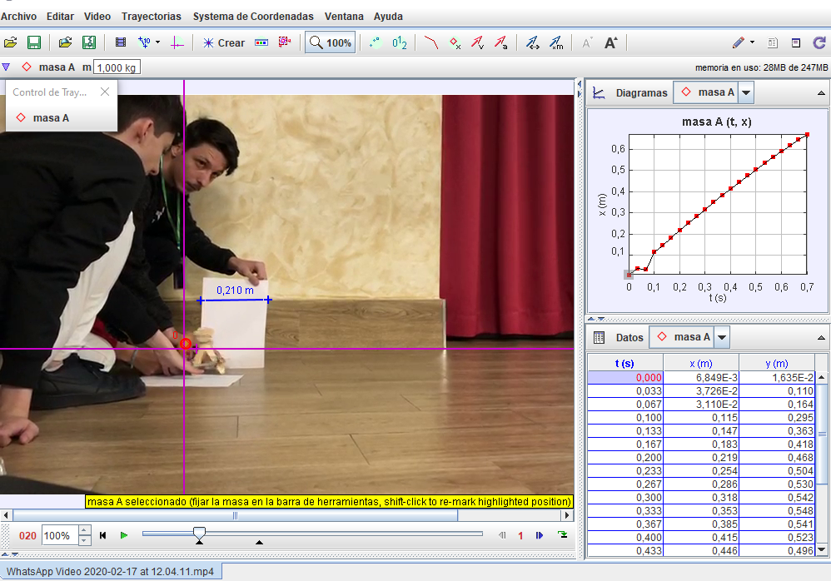
TIMELINE OF THE ACTIVITIES
Introduction (based on images and videos)
Introductory study of the software used
Practical activity
Recording videos
Create digital simulation
Video analysis
Conclusions
Last stage of the activity is the video analysis using the Tracker application, which allows the identification, collection and processing of data collected from previous video recordings
Screenshot of video analysis of a recorded activity, using the mechanism created, using Tracker

Slide 26
TIMELINE OF THE ACTIVITIES
Introduction (based on images and videos)
Introductory study of the software used
Practical activity
Recording videos
Create digital simulation
Video analysis
Conclusions
Students can see that the result of the video analyze is the same for the practical activity video and for the recording of their simulation that was create.
They can discover – or confirm, the basics knowledge regarding the laws of ballistics, the trajectory equation as well as to study the influences for the movement from the medium.
Based on video analysis using Tracker software, scientific conclusions were drawn regarding the proposed topic.
The methodology can be extended to other topics, from physics and engineering, from IT and mathematics perspective.

Slide 27
BEFORE ENDING
5
Any questions?
You can find me at:
morarupetronia@cten.ro
I will be glad to spread our methodology for those who will be interested

Slide 28
THANKS!
It was an honor to present our work for this event

