Slide 1
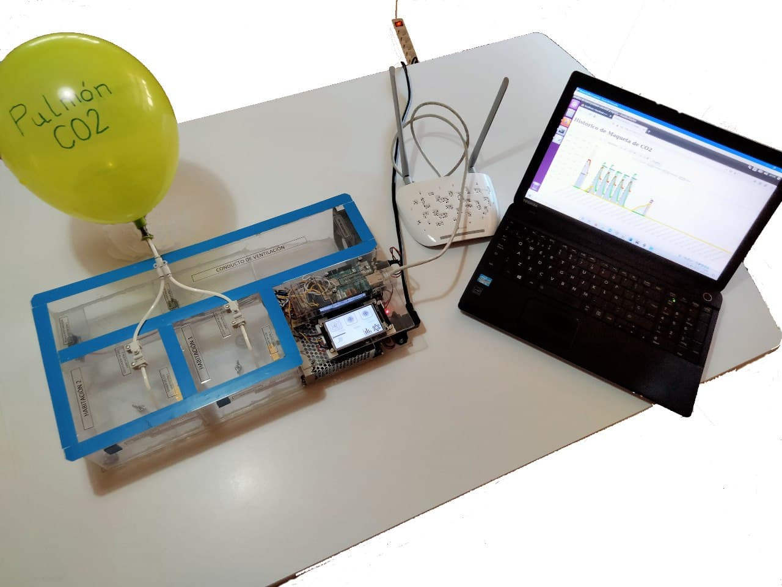
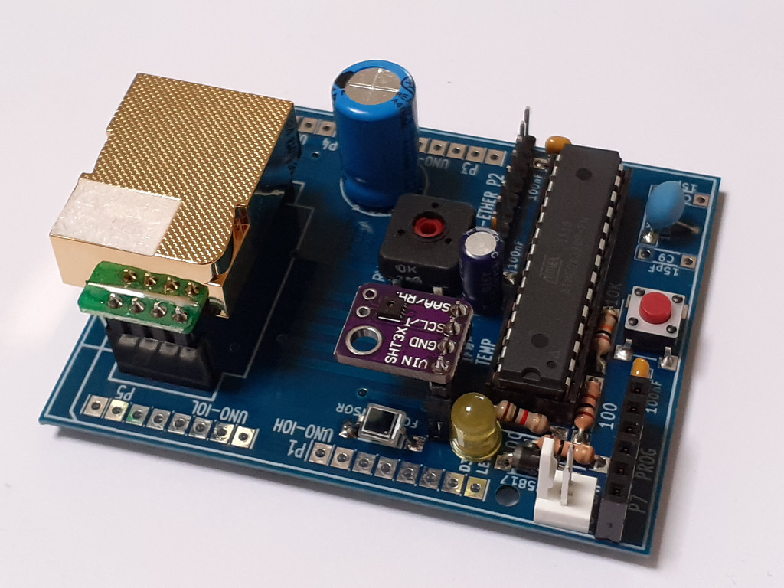
HSCI 2021 Online 19-23 July 2021
MONITORING OF ENVIRONMENTAL PARAMETERS AT SCHOOLS FOR THE IMPROVEMENT OF ACADEMIC PERFORMANCE AND AIRBORNE DISEASES CONTROL
Javier Diz Bugarín¹, José Luis Rodríguez Fernández¹, Montserrat Rodriguez Paz²,
Alejandro Vilela González¹, Manuel Martínez Méndez¹, César Rodríguez López²,
Alberto Pérez Rodríguez³
¹IES Escolas Proval, ²IES Val Miñor, ³Hermes Smart Control (Nigrán, Galicia, Spain)‏
We present the development of a network of environmental sensors for the continuous monitoring of variables like temperature, relative humidity, light and carbon dioxide at high schools in Galicia, Spain.
The information provided by the sensors can be transmitted in real time and stored at a server for processing and public diffusion.
The carbon dioxide levels serve as an indicator of the air quality to help prevent diseases transmission and improving the health and academic performance of the students.
The development of the meters has been supported by an innovation project granted by the Government of Galicia.

Slide 2
HSCI 2021 Online 19-23 July 2021
MONITORING OF ENVIRONMENTAL PARAMETERS AT SCHOOLS FOR THE IMPROVEMENT OF ACADEMIC PERFORMANCE AND AIRBORNE DISEASES CONTROL
INTRODUCTION
Indoor air quality is a factor of great importance for the control of airborne diseases. A low oxygen level or an excess of carbon dioxide can also cause fatigue and cognitive impairment, with serious consequences on health and academic results.
The energy performance of educational buildings is affected by factors such as excessive ventilation and heating.
It is essential to have complete information about the environmental parameters of the buildings with a large number of measurement points and a wide temporal interval. All these data should be centralized and easily accessed for further processing.
To achieve these objectives a team of teachers of two high schools (IES Escolas Proval and IES Val Miñor, Nigrán, Spain) and the local company Hermes Smart Control have started a cooperative project for the development of electronic meters of variables like temperature, relative humidity, light and carbon dioxide levels.
Our proposal will create prototypes of meters that can be connected to the data network of the schools and will send information continuously to a server or store the data in a memory or sd card.
The meters should be economical, reliable, with a variable number of sensors and an installation procedure simple enough so that anyone in the schools can do it without high technical qualification.

Slide 3
HSCI 2021 Online 19-23 July 2021
MONITORING OF ENVIRONMENTAL PARAMETERS AT SCHOOLS FOR THE IMPROVEMENT OF ACADEMIC PERFORMANCE AND AIRBORNE DISEASES CONTROL
OBJECTIVES OF THE PROJECT
This project has many applications in science and technology educations. Among others, the main objectives of the project are:
Development of measurement systems of different environmental parameters with data acquisition, storage and communication capabilities.
Preparation of innovative practical lessons for students of electronics and technology about sensors, data acquisition, communications and programming.
Technology transfer between educational centers and companies for the development of new systems and products.
Improve the employment opportunities of the students through the participation in a real R&D experience.
Acquire a better knowledge about the environmental status and energy efficiency of the educational buildings for the implementation of innovative solutions.
Promote the interest of students of all levels about environment and energy efficiency.

Slide 4
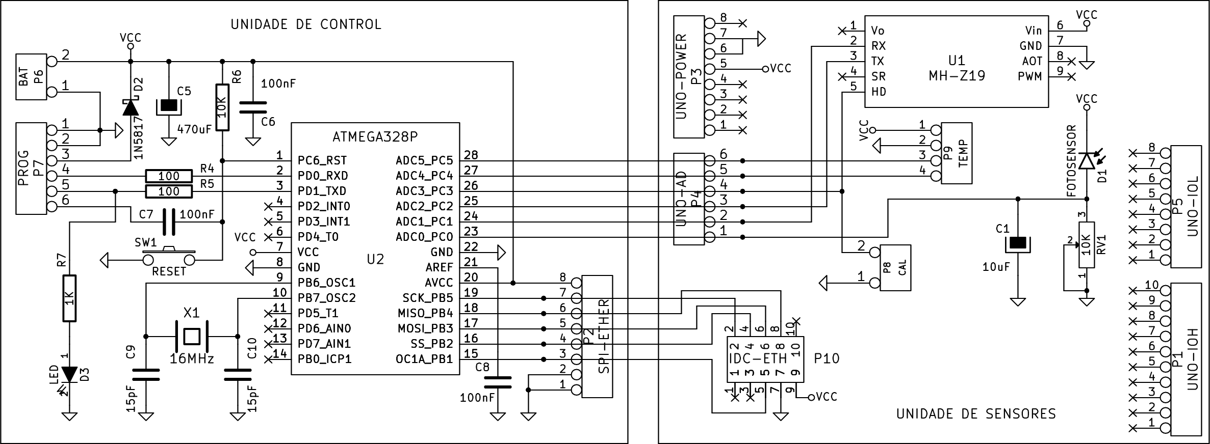
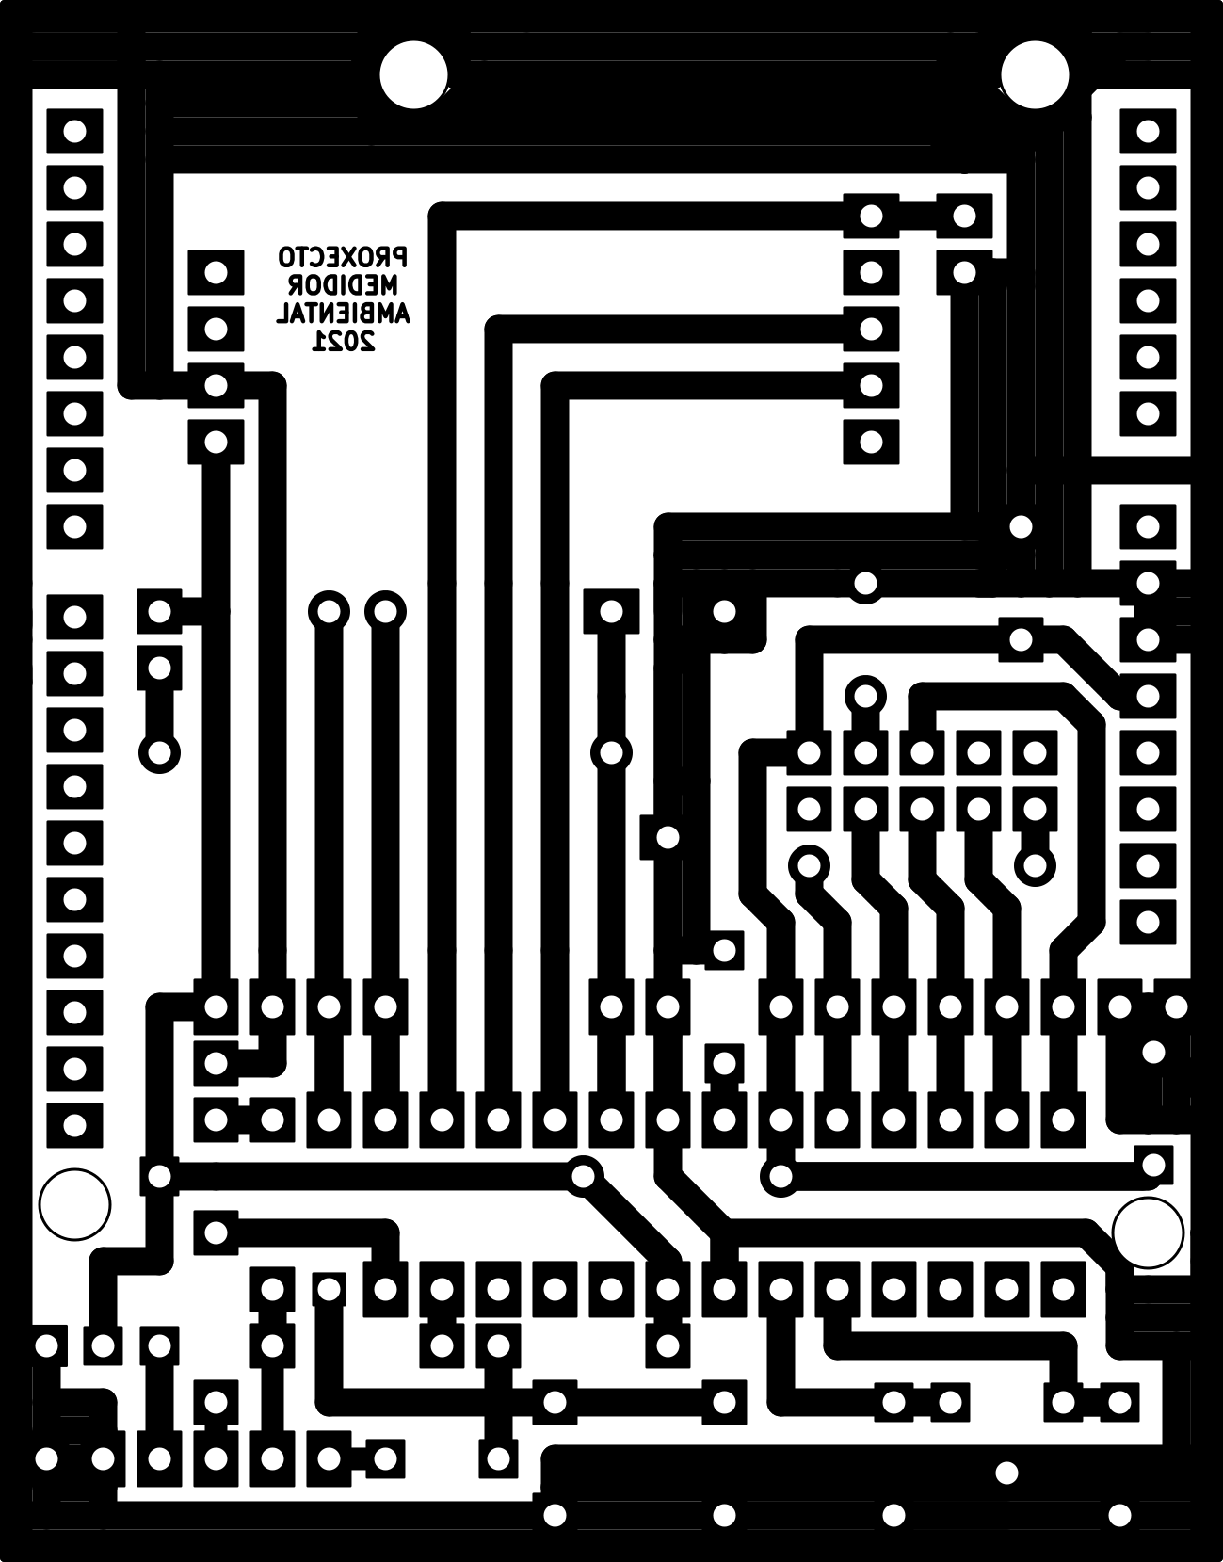
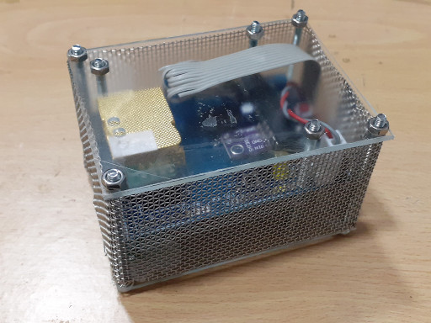
HSCI 2021 Online 19-23 July 2021
MONITORING OF ENVIRONMENTAL PARAMETERS AT SCHOOLS FOR THE IMPROVEMENT OF ACADEMIC PERFORMANCE AND AIRBORNE DISEASES CONTROL
ELECTRONIC PROTOTYPES: ARDUINO CONNECTED METER
Compatible with Arduino boards and IDE for ease of programming and development.
Uses an Atmega328P-PU microcontroller.
Ethernet module with a Wiznet W5500 chip and RJ45 cable connection.
Winsen MH-Z19C NDIR carbon dioxide sensor.
Other sensors: Sensirion SHT30 for temperature and RH, BPW34 photodiode.
Powered by an usb connector to allow the use of recycled power supplies (phones...).
No screen or keyboard to reduce cost.
The data can be consulted on the web page of the project. Each meter has its own space: http://codos.meteoproval.es/blog/medidor-1
We have made our own PCB design compatible with Arduino Pro-Mini boards.

Slide 5
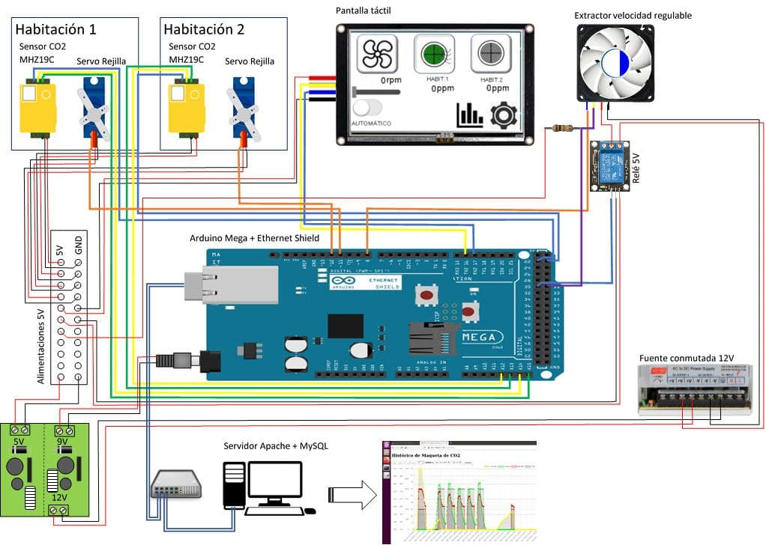
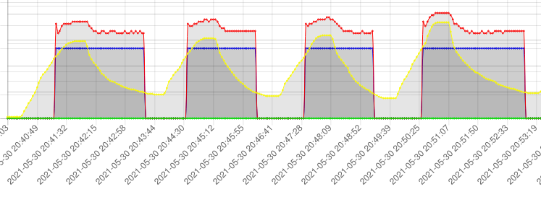
HSCI 2021 Online 19-23 July 2021
MONITORING OF ENVIRONMENTAL PARAMETERS AT SCHOOLS FOR THE IMPROVEMENT OF ACADEMIC PERFORMANCE AND AIRBORNE DISEASES CONTROL
ELECTRONIC PROTOTYPES: VENTILATION EDUCATIONAL MODEL
Ventilation system for two rooms.
Automatic control of two gates by a servomotor and an air extractor.
Controls the ventilation time and air flow.
The system variables can be observed locally on a 3.4 inch touch screen and on a data server.
Presents the CO2 concentration, the fan speed and the condition of the gates.
Based in an Arduino Mega 2560, with enough memory for large amount of data.
Communicates with and external MySQL-Apache server that allows massive data storage and processing.
Nextion Enhanced touch screen with real time clock (RTC).
Winsen´s MHZ19C CO2 sensor.

Slide 6
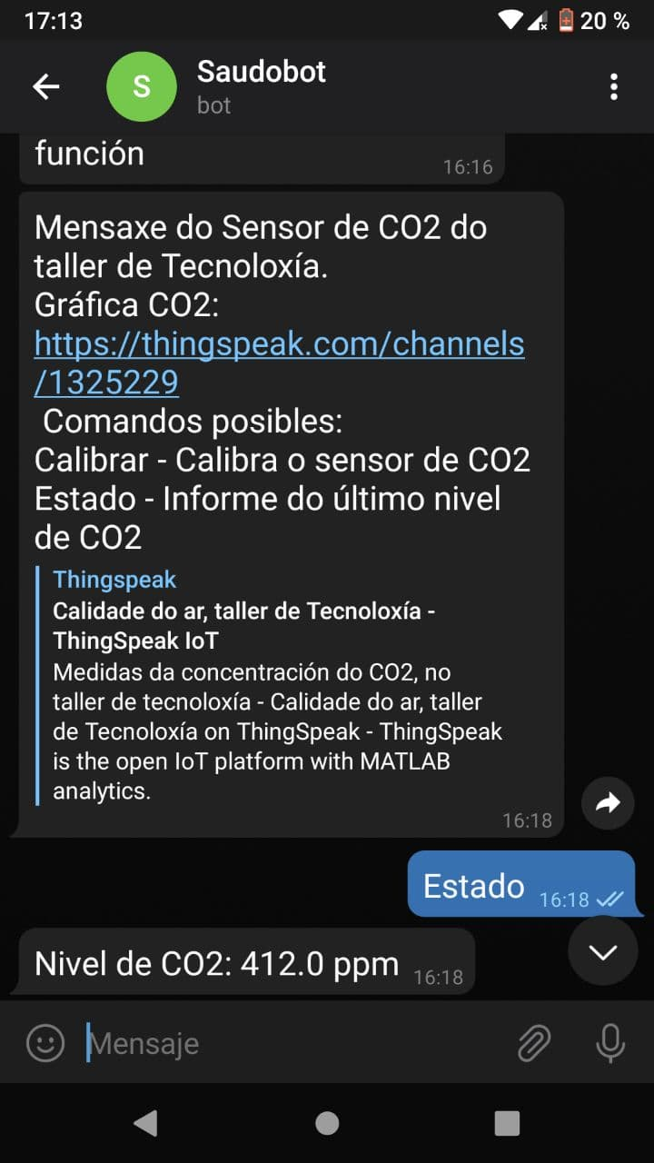
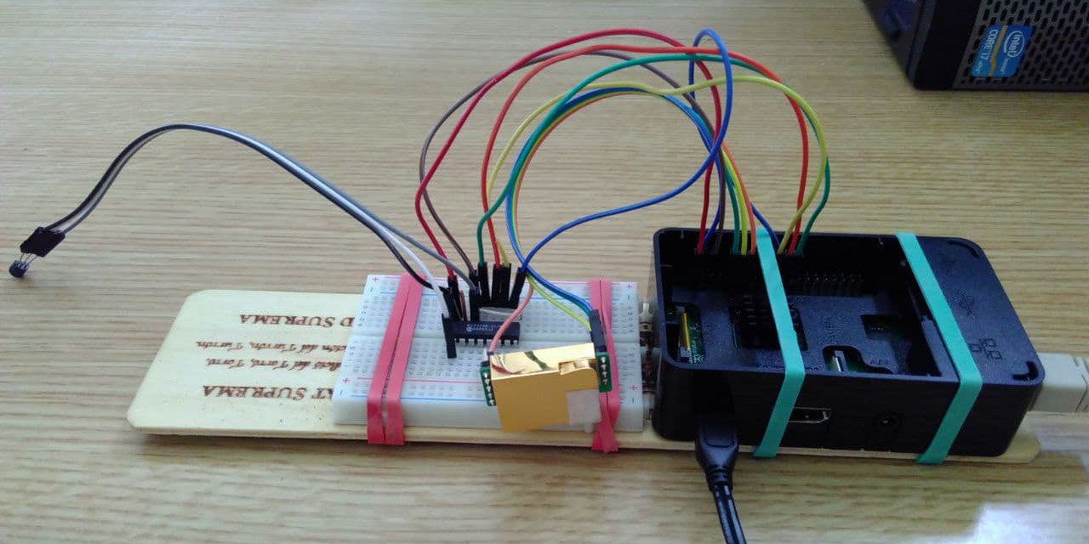
HSCI 2021 Online 19-23 July 2021
MONITORING OF ENVIRONMENTAL PARAMETERS AT SCHOOLS FOR THE IMPROVEMENT OF ACADEMIC PERFORMANCE AND AIRBORNE DISEASES CONTROL
ELECTRONIC PROTOTYPES: RASPBERRY PI METER
Prototype based on a Raspberry Pi 2.
Uses the Processing IDE (PDE) for Raspbian operating system.
Reads a Winsen MH-Z19C sensor using its PWM output.
The data are sent to the internal server of the educational center and also to the Thinkspeak website.
Communicates with users by a Telegram chat. Commands: /State and /Calibration. (current CO2 level and base level calibration).
Uses a Microchip MCP3208 A/D converter to read a LM35 temperature sensor.

Slide 7
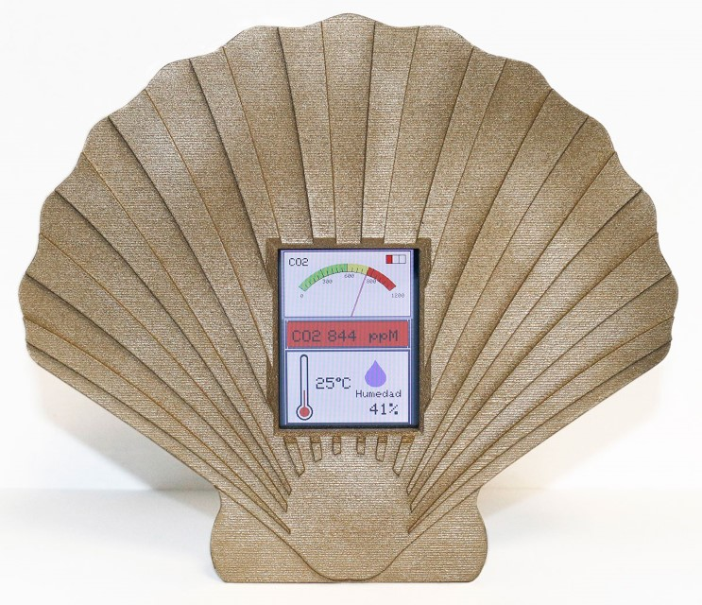
HSCI 2021 Online 19-23 July 2021
MONITORING OF ENVIRONMENTAL PARAMETERS AT SCHOOLS FOR THE IMPROVEMENT OF ACADEMIC PERFORMANCE AND AIRBORNE DISEASES CONTROL
ELECTRONIC PROTOTYPES: QAIR HERMES METER
The company Hermes Smart Control is developing its own carbon dioxide meter named Qair.
The meter has a screen that indicates the level in ppm and a three colour code that allows users to easily check the status with a quick view.
Its shape remembers a ‘vieira’, the well known icon of the Way of St James and also a symbol of galician gastronomy..
The meter has been presented in May 2021 and will soon start production.

Slide 8
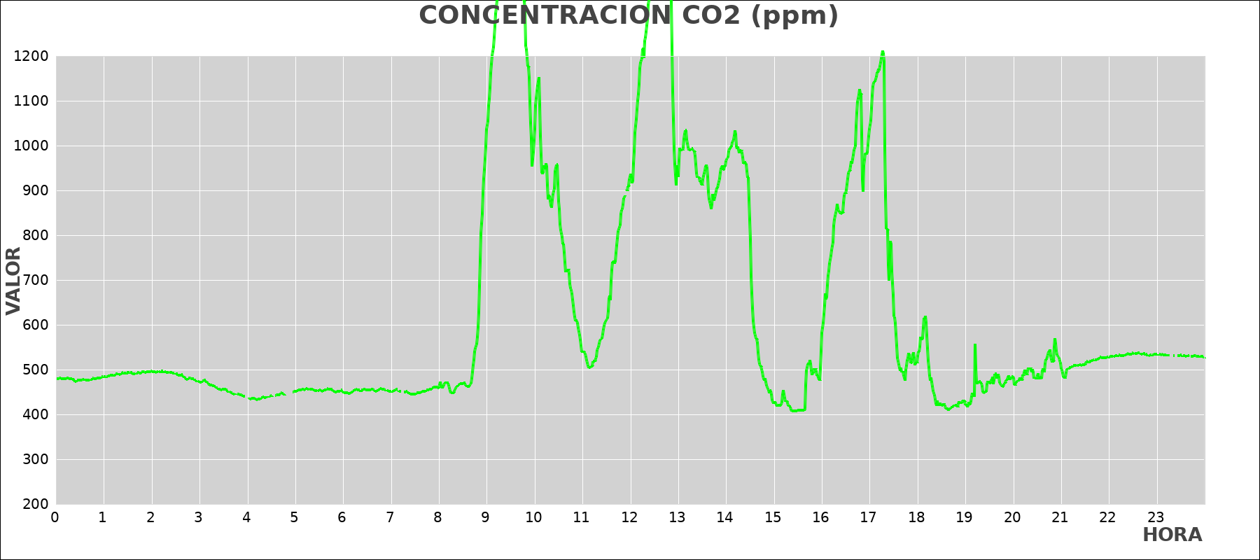
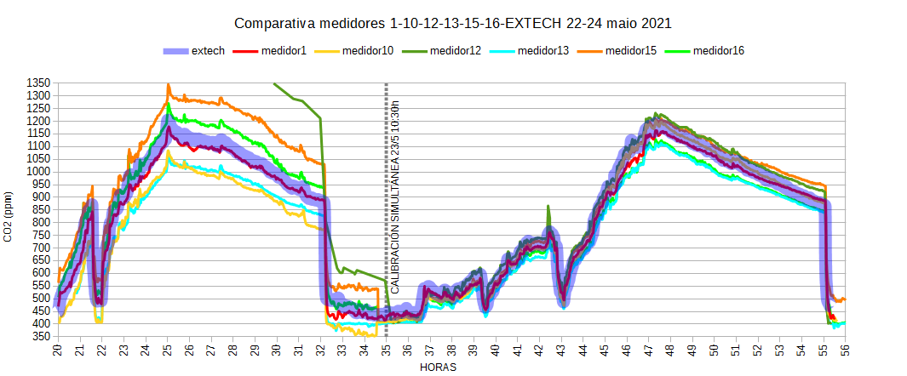
HSCI 2021 Online 19-23 July 2021
MONITORING OF ENVIRONMENTAL PARAMETERS AT SCHOOLS FOR THE IMPROVEMENT OF ACADEMIC PERFORMANCE AND AIRBORNE DISEASES CONTROL
PRELIMINARY RESULTS
As an example of the results obtained we present an analysis of the data obtained during an exam day at IES Escolas Proval. In this date (May 3rd) the ventilation was insufficient and carbon dioxide levels achieved levels as high as 1680 ppm at 9:34h, 1610 ppm at 12:45h and 1213 at 17:16h. The mean level during the morning was 1005 ppm (8:45‑14:30h) and during the afternoon was 813 ppm (16:00‑18:10h). This data exceeded the recommended values and probably had a deep impact on the welfare and academic performance of the students.
An important part of the project is the comparison of the prototypes with a reference meter which gives information about the quality of the measures obtained. For this purpose we acquired an Extech (FLIR) CO260 carbon dioxide meter.
Each set of new meters have been calibrated before placing them in the classrooms. The representation of the measurements of the meters before and after the calibration procedure shows a good convergence of the values.

Slide 9
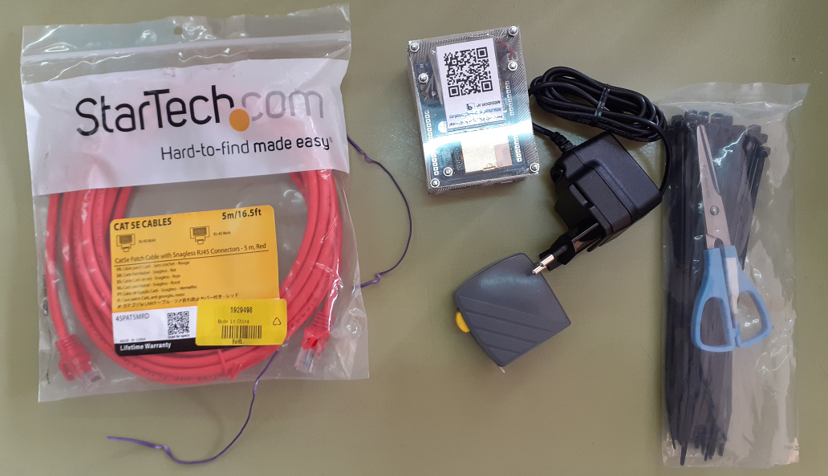
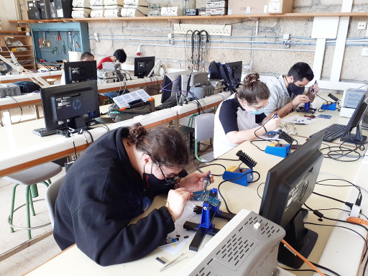
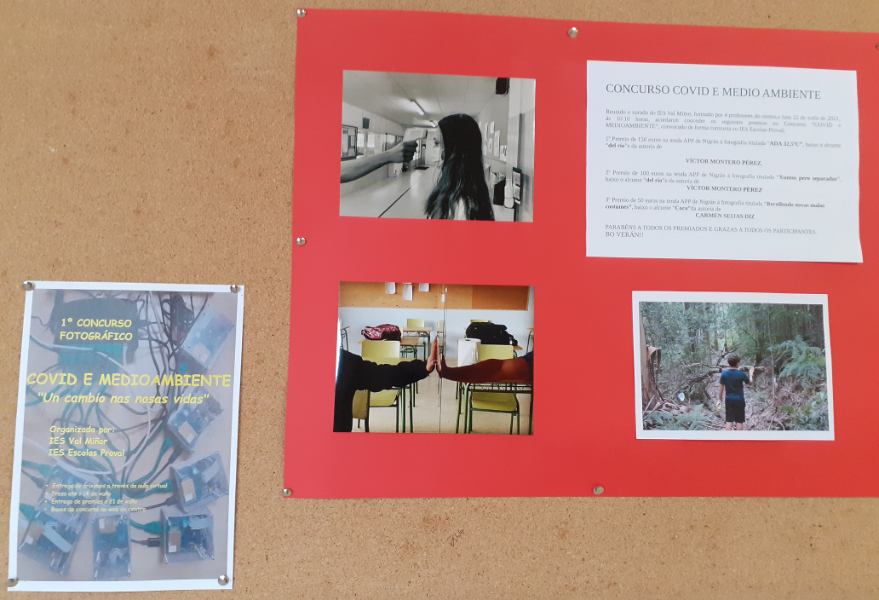
HSCI 2021 Online 19-23 July 2021
MONITORING OF ENVIRONMENTAL PARAMETERS AT SCHOOLS FOR THE IMPROVEMENT OF ACADEMIC PERFORMANCE AND AIRBORNE DISEASES CONTROL
EDUCATIONAL ACTIVITIES: THE COVID SENTINELS OF VAL MIÑOR
At the beginning of course 2020-21 the management and Physics department of IES Val Miñor started a program for the analysis of the carbon dioxide concentration in the classrooms, with the cooperation of many other teachers were involved: History, Biology, Technology, Mathematics, Galician Language, French and others.
At this point it was proposed to participate in the innovation project with IES Escolas Proval. The installation of four new meters allowed to make a selection of classrooms attending to their orientation, number of students and distribution of doors and windows.
But the most important task was the selection of the human resources that would be in charge of the measurements: the students. They shoud take care of the meters and detect any event that could affect the measurements. Without their cooperation the information provided by the meters would lack important data to understand what was happening.
As a final activity we organized an online photograph contest through the virtual classrooms of both high schools.

Slide 10
HSCI 2021 Online 19-23 July 2021
MONITORING OF ENVIRONMENTAL PARAMETERS AT SCHOOLS FOR THE IMPROVEMENT OF ACADEMIC PERFORMANCE AND AIRBORNE DISEASES CONTROL
CONCLUSIONS
In this paper we have presented a cooperative project made by two spanish high schools, IES Escolas Proval and IES Val Miñor and the company Hermes Smart Control.
The project was aimed to the development of environmental meters with different sensors and capabilities.
Some prototypes have been already made and are acquiring and storing data to provide information about the ventilation of spaces and to improve the welfare and academic performance of students.
The company Hermes is developing its own meter for restaurants and other business.
Many students of the educational centers were involved in the project and were responsible for the meters, the data registers and external conditions.
This activity helped them to became aware of their own skills and feel valued.

Slide 11
HSCI 2021 Online 19-23 July 2021
MONITORING OF ENVIRONMENTAL PARAMETERS AT SCHOOLS FOR THE IMPROVEMENT OF ACADEMIC PERFORMANCE AND AIRBORNE DISEASES CONTROL
The authors would like to thank the students of the Vocational Training Degree “Mantemento Electrónico” at IES Escolas Proval and the students of ESO at IES Val Miñor and Escolas Proval for their important contribution to the activities of the project.
Also to Xunta de Galicia for funding the Vocational Training Innovation Project entitled “Continuous monitoring of physical parameters for the improvement of environmental quality in educational buildings”.
THANK YOU
FOR YOUR ATTENTION!!

