Slide 1
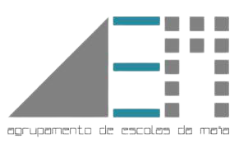
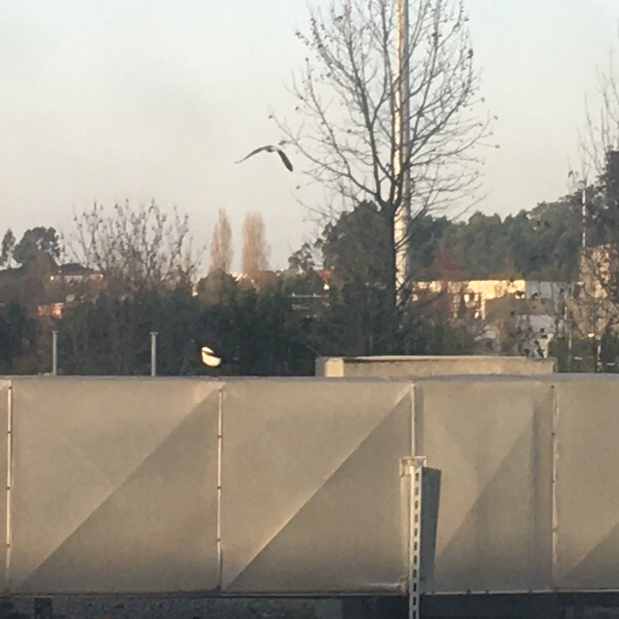
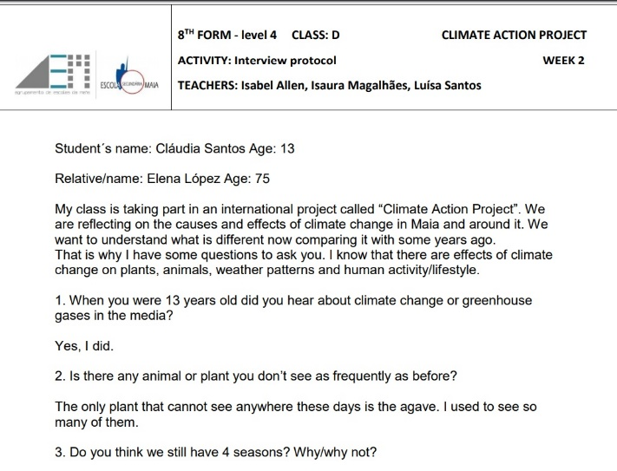
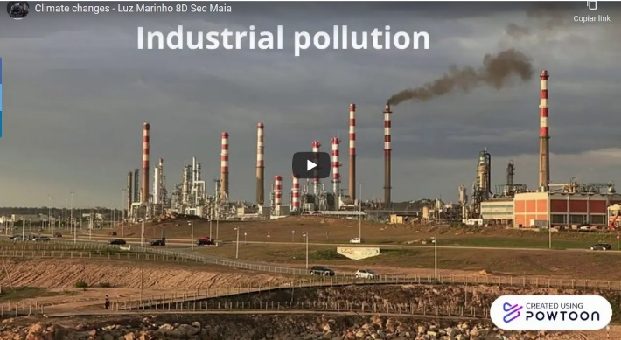
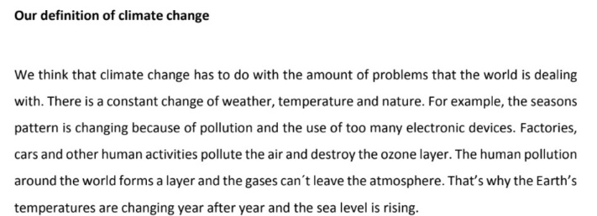
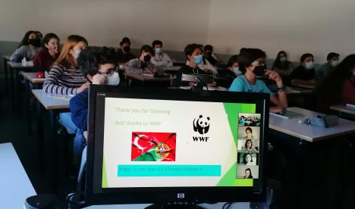
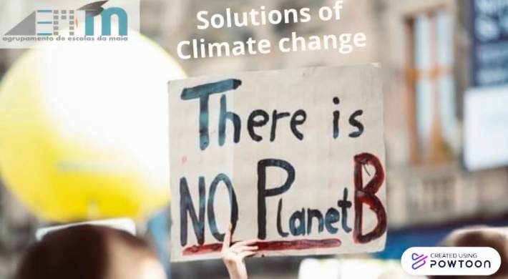
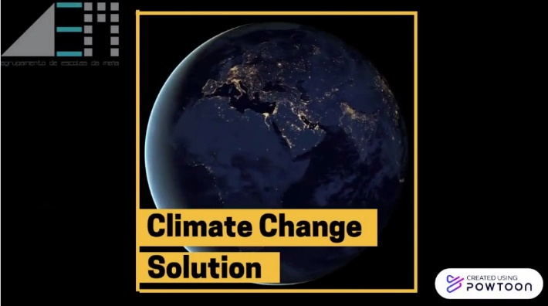
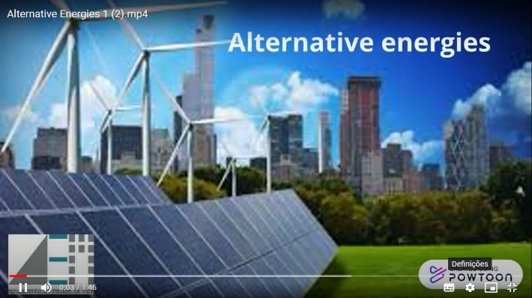
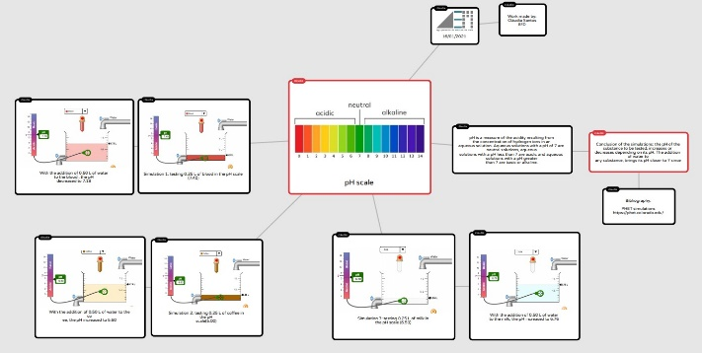
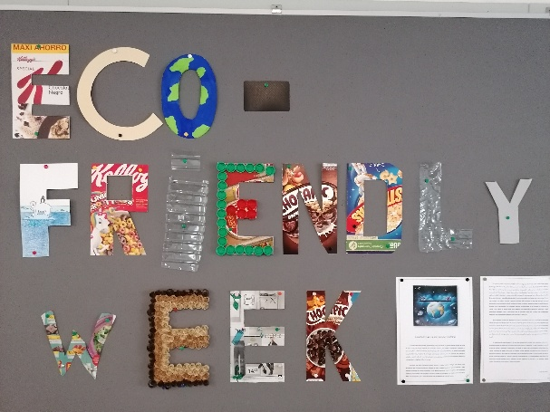
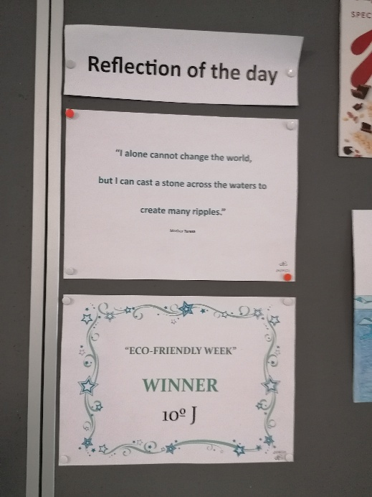
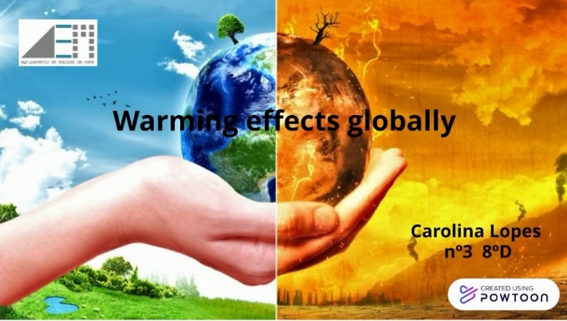
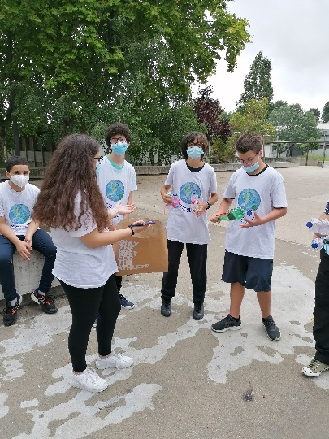
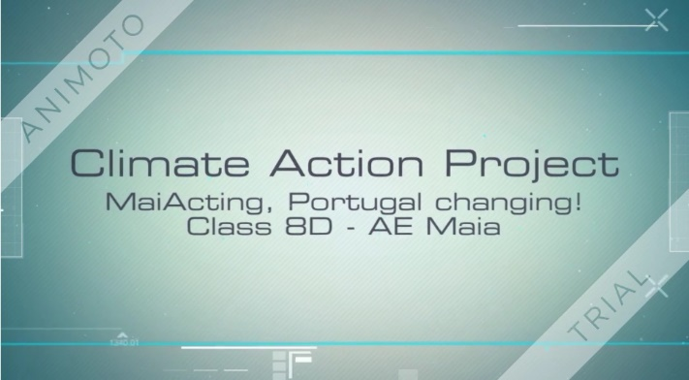
MaiActing, Portugal Changing!
A Climate Action Project in an 8th grade CLIL Class
Isabel Allen, Isaura Magalhães, Luísa Santos
Agrupamento de Escolas da Maia, Maia, Portugal
isaura.magalhaes@aemaia.com
Introduction
Results
Students from the 8th grade, class D, from the School Cluster of Maia participated in the Climate Change Project 2021. This project aimed to use project-based learning to increase understanding and engagement with these key real-world issues, while improving problem-solving and critical thinking skills, building empathy, and fostering creativity and collaboration.
Week 2
Week 1
Methodology
Figure 1. Week 1: Our definition of climate change
Figure 2. Week 2: Birds in our school. Photograph from Carolina Lopes, 8th grade.
Figure 3. Week 2: Interview protocol done by Cláudia Santos, student of the 8th grade, to her grandmother (aged 75).
Figure 4. Week 2: Effects of climate change on Portugal and around Maia. Work done by Luz Marinho, 8th grade student. https://youtu.be/7ElvNE0kWYU
Every week students had some questions for the week to reflect on and, after exploring possibilities, they had to present a collective action related to those questions. Each week the work done as well as a video with the actions taken, done using the APP Powtoon, were shared in the Climate Action website.
Week 3
Week 4
Figure 5. Week 3: Virtual exchange with a Turkish school.
Figure 6. Week 3: Climate Change. Work done by Nuno Aroso, 8th grade student.
https://youtu.be/IRM9iIdl0xM
Conclusions
Figure 8. Week 4: Climate Change Solution.
https://www.youtube.com/watch?v=wqd8Cd9-cvQ
Figure 9. Week 4: Video made by 8th grade students Maria João Ramos and Matilde Laranjeira
https://youtu.be/3JZdPPQNIno
The project promoted an expansion of students' scientific knowledge, developed their critical, deductive and creative thinking and fostered a taste for science. Moreover, students had the opportunity to form positive habits and values that they can carry outside of school and beyond their school life.
Figure 7. Mind Map Popplet: pH Scale. Work done by Cláudia Santos, 8th grade student.
Week 6
Week 5
References
.
Sierra, J. M. (2016). Cooperative projects in a CLIL course: What do
students think? In D. Lasagabaster & A. Doiz (Eds.), CLIL
experiences in secondary and tertiary education (pp. 69–98).
Golonka, E.M., Bowles, A.R., Frank, V.M., Richardson, D.L.,
Freynik, S. (2014). Technologies for foreign language learning: A
review of technology types and their effectiveness. Computer
Assisted Language Learning 27, 70–105.
https://public.wmo.int/en/media/press-release/2019-concludes
decade-of-exceptional-global-heat-and-high-impact-weather
https://www.nasa.gov/press-release/nasa-noaa-analyses-reveal
2019-second-warmest-year-on-record
https://www.climate-action.info/
Figure 11. Week 6: Call for action: Letters done with recycled materials by students from the 8th grade, class D.
Figure 13. Week 6: Eco-Friendly Week winner.
Figure 10. Week 5: Climate Change solutions. Work done by Carolina Lopes, 8th grade student.
https://www.youtube.com/watch?v=0kGakb8UleA
Figure 12. Week 6: Eco-Friendly Week: Plastic Hunt.
Figure 14: Week 6: Final video of the project Climate Change.
https://www.youtube.com/watch?v=Kp6aKG7bado

