Slide 1
Eco-stop
AiRescue

Slide 2
Index
Introduction;
Problem to be solved;
Green Roof - types of green roofs and their constitution;
Benefits of Green Roofs;
Targeted Bus Stop;
Materials;
Experimental Procedure and expected results;
Partnerships;
Conclusion.

Slide 3
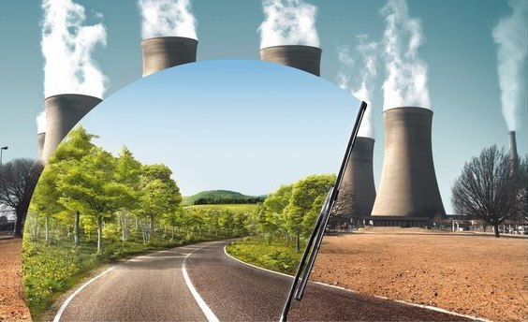
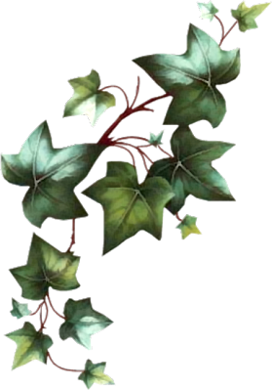
Introduction
The industrial evolution and the problems related to this one imply the develop of sustainable measures able to soften the new environmental consequences that worsen daily. It implies the elaboration of projects like ECO-Stop.
Fig.1

Slide 4
Problem to be solved
ECO-Stop is a project that search to solve the environmental impacts that come from emissions of toxic gases to the atmosphere like the greenhouse effect and the increase of the global temperature. Allied to the primordial function of this green roofs, the aesthetic effect that it gives to the urban space makes this project the most beautiful of the sustainable measures.
Fig.2
Fig.3
Fig.4

Slide 5
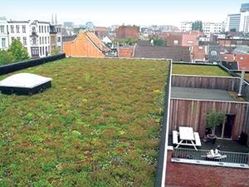
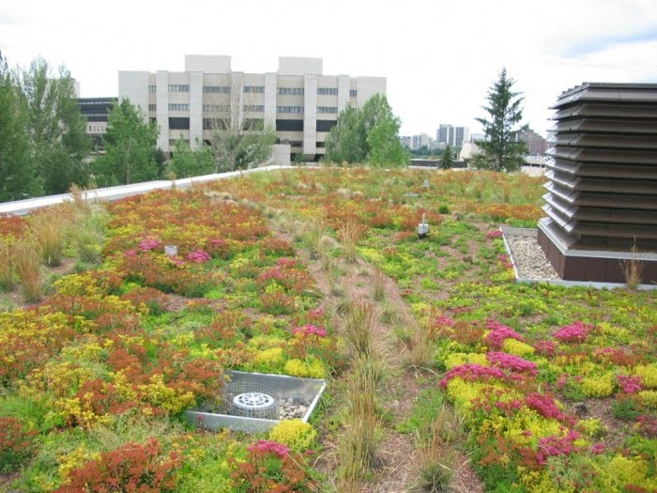
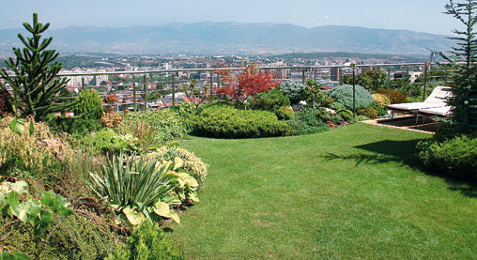
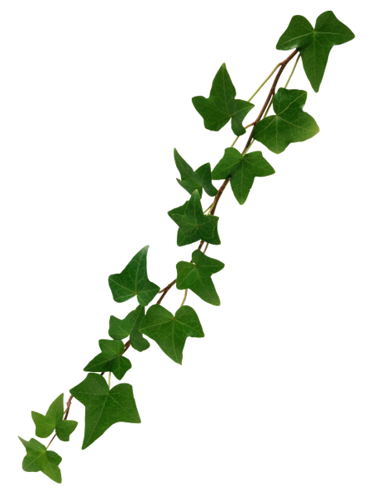
Green Roofs - types of green roofs
Fig.5
Fig.6
Fig.7
Extensive
Semi - intensive
Intensive

Slide 6
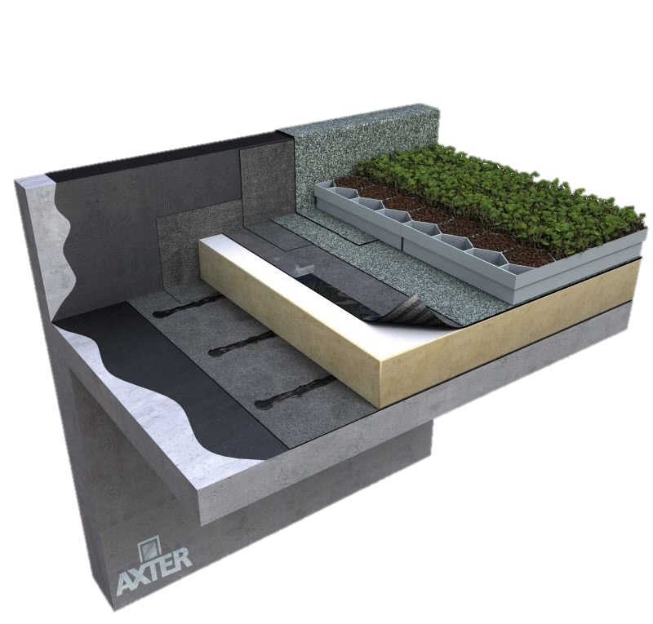
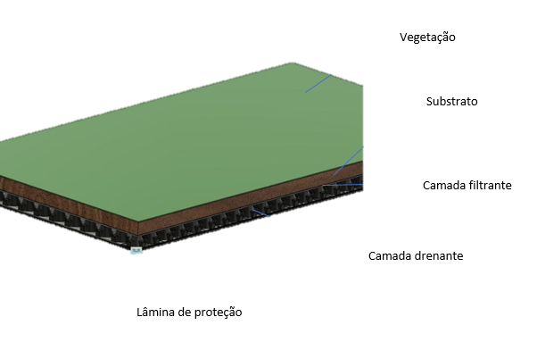
Green Roofs – constitution
Vegetation
Substrate
Filtering Layer
Draining Layer
Protection Sheet
(Anti-root mechanical protection)
Fig.8
Fig.9

Slide 7
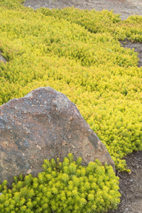
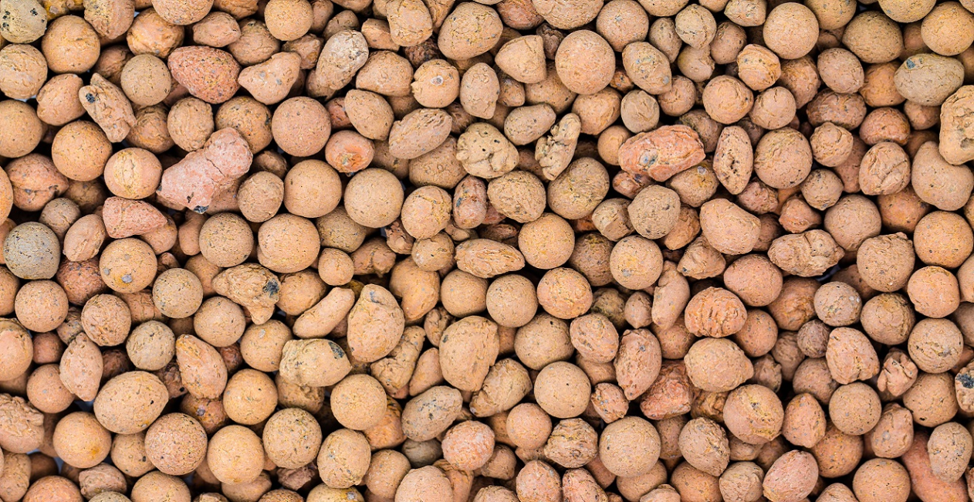
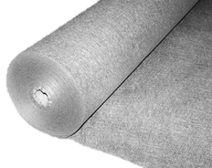
Materials
Vegetation
Fig.10
Substrate
Sedum
Fig.11
Filtrating Layer
Expanded clay
Fig.12

Slide 8
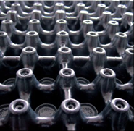
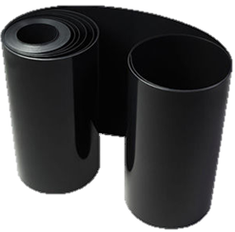
Materials
Draining Layer
Fig.13
Anti-root mechanical protection
Fig.14

Slide 9
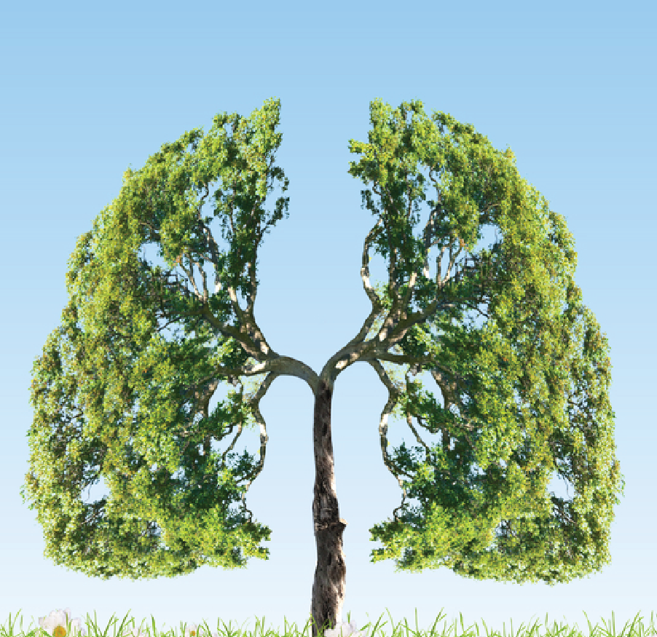
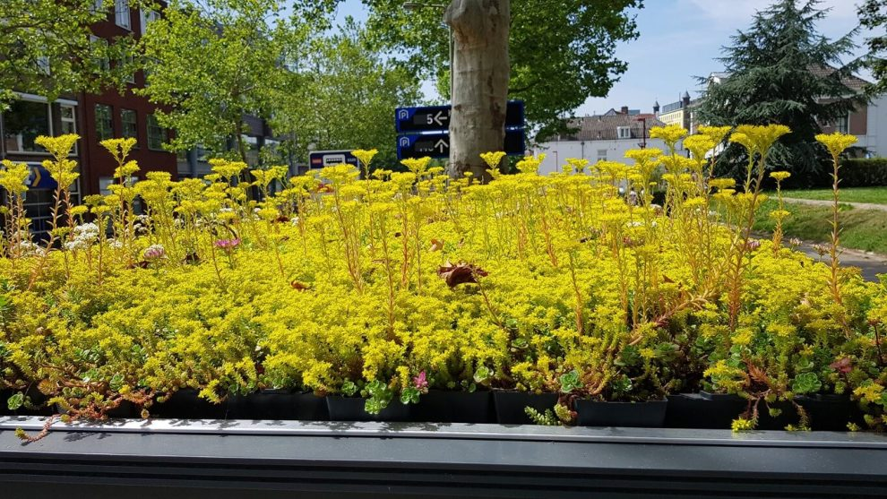
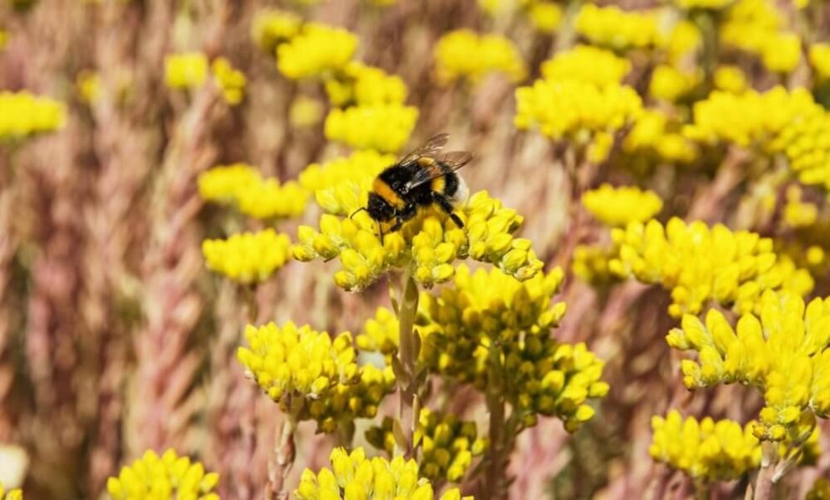
Benefits of Green Roofs
Besides the aesthetic effect already referred, this project also offers other benefits like:
The constant oxygenation of air, making it healthier for all the citizens;
Allows the decrease of the heat island;
Increases the biodiversity through the creation of habitats for the species;
Countless other advantages not just for the environment but also for the city itself and for the people that live in it.
Fig.15
Fig.16
Fig.17

Slide 10
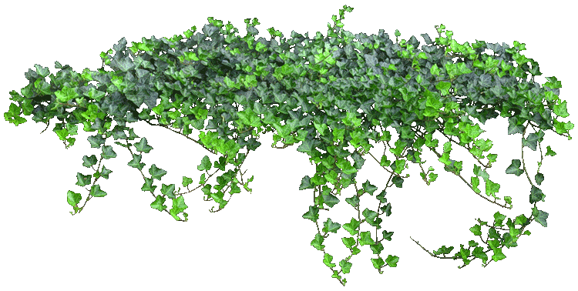
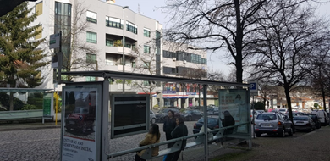
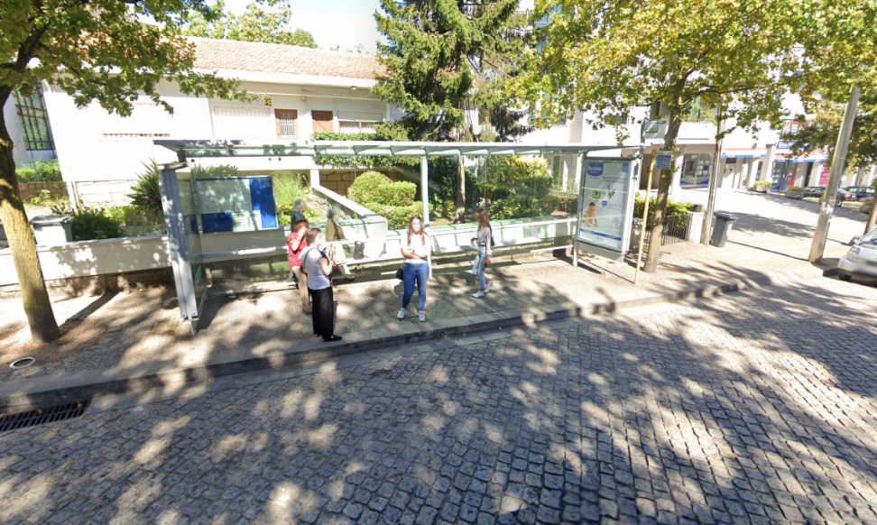
Targeted Bus Stop
Fig.18
Fig.19
The targeted Bus Stop that would be the sample for the prototype for our pilot project would be situated in Avenida Dom Manuel II, near the City Council of Maia.

Slide 11
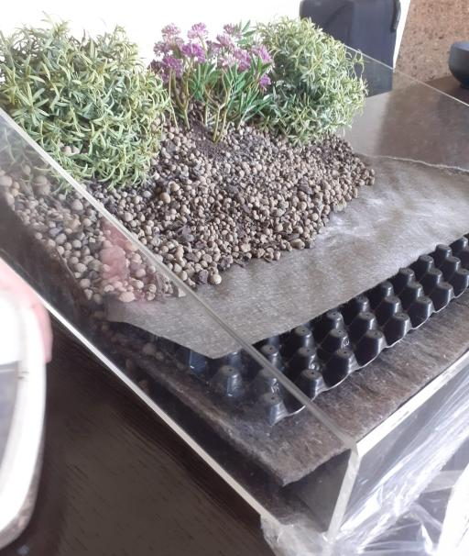
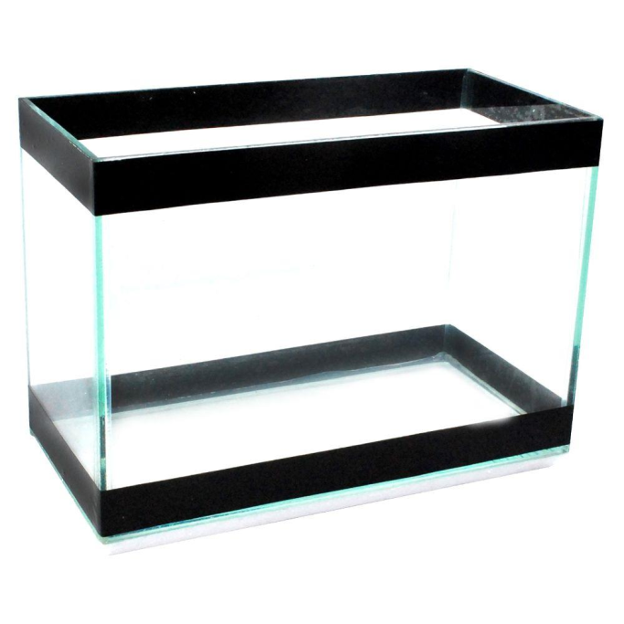
Experimental procedure
baseancv@greenroofs.pt
Message @Rafael5
baseancv@greenroofs.pt
Message @Rafael5
baseancv@greenroofs.pt
Message @Rafael5
baseancv@greenroofs.pt
Message @Rafael5
Building a prototype in a lower scale in put it in a close enclosure;
Evaluating the concentration of CO2 and the temperature along the time.
Fig.20
Fig.21

Slide 12
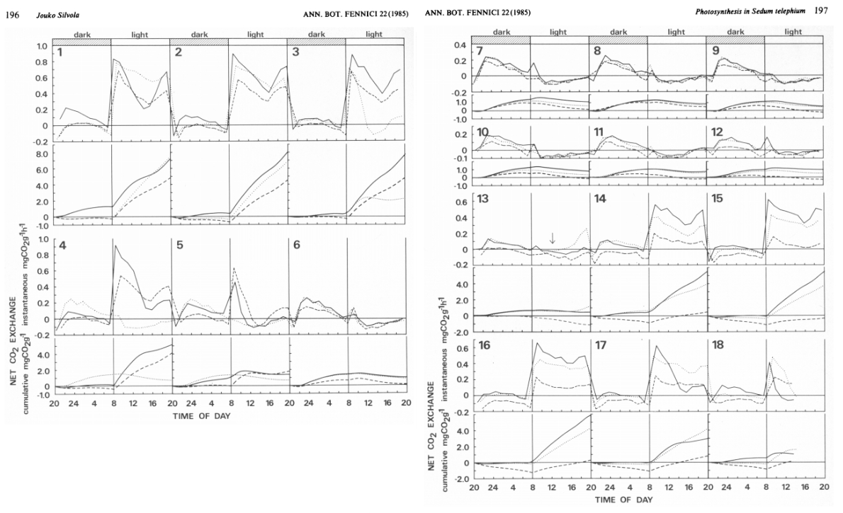
Experimental procedure Expected results – Carbon Dioxid
baseancv@greenroofs.pt
Message @Rafael5
baseancv@greenroofs.pt
Message @Rafael5
baseancv@greenroofs.pt
Message @Rafael5
baseancv@greenroofs.pt
Message @Rafael5
Study made by Silvora (1985), a Finnish scientist, that had the purpose of evaluate the accumulation of carbon dioxide in a Sedum plant.
Fig.22

Slide 13
Experimental procedure Expected results - Temperature
baseancv@greenroofs.pt
Message @Rafael5
baseancv@greenroofs.pt
Message @Rafael5
baseancv@greenroofs.pt
Message @Rafael5
baseancv@greenroofs.pt
Message @Rafael5
According with the study made by the federal Catarinense institute, the temperature of the interior of the encloser should be lower that the exterior temperature in the hours of higher solar exposer.
Fig.23
Fig.24

Slide 14
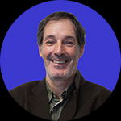
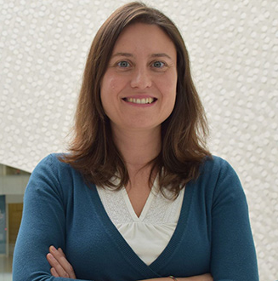
Partnerships
baseancv@greenroofs.pt
Message @Rafael5
baseancv@greenroofs.pt
Message @Rafael5
baseancv@greenroofs.pt
Message @Rafael5
baseancv@greenroofs.pt
Message @Rafael5
ISMAI – Dr. Manuel Cunha
mpcunha@ismai.pt
Engª Cristina Calheiros (CIIMAR)
Arqª Jéssica Fogeiro
cristina@calheiros.org
baseancv@greenroofs.pt

Slide 15
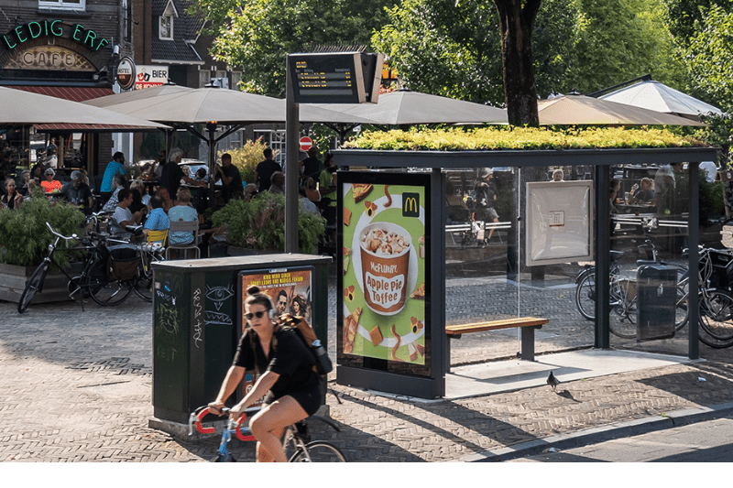
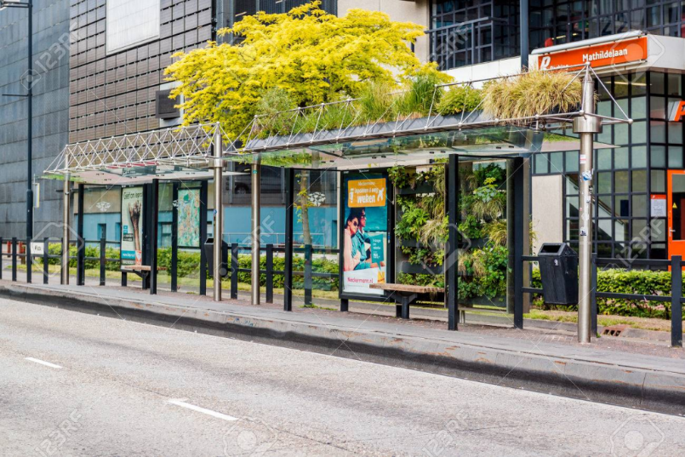
Conclusion
Fig.26
Fig.25
Membros do projeto ECO-Stop: Gonçalo Rocha, nº9;
Pedro Silva, nº19;
Rafael Silva, nº20;
Sara Machado, nº21.

Slide 16
Bibliography/Webgraphy
Intergovernmental panel about climatic changes, Global Warmingof 1,5 % https://www.ipcc.ch/site/assets/uploads/2019/07/SPM-Portuguese-version.pdf (June 24 th 2020)
(ANCV)https://www.greenroofs.pt/ [January 16th 2020]
PALHA, Paulo; AFONSO, Armando et al. (2019) "Coberturas Verdes - Guia Técnico". "Guia técnico para projeto, construção e manutenção de coberturas verdes". 1ª edição Porto: ANCV
Landlab "Landlab" https://www.landlab.pt/ (March 11th 2020)
WEBER, Alex; ROSA, Cássia; DA ROCHA, Débora; FUNFGELT, Karla. "TELHADO VERDE - AVALIAÇÃO DE TEMPERATURA COM UTILIZAÇÃO DE DIFERENTES TIPOS DE COBERTURA VEGETAL" Anais da XV FETEC (Feira de Conhecimento Tecnológico e Científico) http://eventos.ifc.edu.br/micti/wp-content/uploads/sites/5/2014/09/MUL-94.pdf , agosto de 2014 (March 24 th 2020)
SILVOLA, JOUKO. “Photosynthesis Measurements on a CAM Plant, Sedum Telephium (Crassulaceae).” Annales Botanici Fennici, vol. 22, no. 3, 1985, pp. 195–200. JSTOR, www.jstor.org/stable/23725702 (May 23rd 2020)

Slide 17
Bibliography/Webgraphy - images
1- https://www.otj247.com/static/uploads/1487317248.48_3.png
2- https://nccmed.com/wp-content/uploads/2020/01/Factory-with-their-air-pollution-activity.jpg
3- https://s3-us-west-1.amazonaws.com/greenfuture/uploads/posts/January2017/gWwqi0xtb0CBBo0m2Hie.jpg
4- https://miro.medium.com/max/6016/1*Fb6JEUqgoF_nKDWiYWxXSA.jpeg
5- https://www.resitrix-epdm.be/sites/default/files/styles/large/public/groendak_algemeen.jpg?itok=TcBTiC5r
6- https://4.bp.blogspot.com/_vqHfixke1L8/TDzvIlCnEVI/AAAAAAAAB3g/FHkQtisn7js/s1600/art51.jpg
7- n.d. (Image of an intensive green roof)
9- https://img.archiexpo.com/images_ae/photo-m2/1784-12246685.jpg
10 - https://b.allegroimg.com/s512/01da38/e3a0c4d44e5faf6351449fbaf8ab/Rozchodnik-ANGELINA-na-SKALNIAK-bylina-W-DONICZCE-Rodzaj-rosliny-Inny
11 - https://http2.mlstatic.com/argila-expandida-18kg-vasos-jardim-decoraco-12-sacos-D_NQ_NP_835521-MLB20799429074_072016-F.jpg
12 - http://www.pavipool.es/producto/malla-antihierbas/
13- https://img.archiexpo.com/images_ae/photo-g/66377-8410753.jpg
14- https://mnrainman.com/WebRoot/Store11/Shops/dc916bd1-9efb-499b-9e4e-893614b67d4c/59B6/90A8/6199/3313/BC6B/0A48/3633/D23B/HDPE_2mm_Wurzelschutz_Wurzelsperre_Rhizomsperre_Wurzelschaeden.png
15 - https://mathanggiperumall.files.wordpress.com/2018/02/kepentingan-sistem-respirasi-yang-sihat.pdf

Slide 18
Bibliography/Webgraphy - images
16- https://assets.rbl.ms/19807721/origin.jpg
17- https://www.iamexpat.nl/sites/default/files/styles/article--full/public/bee_on_sedum_flowers.jpg?itok=LO5ocOVP
18 e 19 - https://www.google.pt/maps/@41.2338783,8.6204669,3a,75y,329.67h,79.05t/data=!3m6!1e1!3m4!1sZo_vTxk0pKXzIXUGWjt5NA!2e0!7i16384!8i8192
21- https://http2.mlstatic.com/aquario-kit-completo-30-cm-x-30-cm-x-30-cm-vidro-4-mm-D_NQ_NP_753758-MLB31799362011_082019-F.jpg
22 - SILVOLA, JOUKO. “Photosynthesis Measurements on a CAM Plant, Sedum Telephium (Crassulaceae).” Annales Botanici Fennici, vol. 22, no. 3, 1985, pp. 195–200. JSTOR, www.jstor.org/stable/23725702 (23 de maio de 2020)
23 - https://upload.wikimedia.org/wikipedia/commons/thumb/2/27/Instituto_Federal_de_Santa_Catarina_-_Marca_Vertical_2015.svg/894px-Instituto_Federal_de_Santa_Catarina_-_Marca_Vertical_2015.svg.png
24 - https://www.istockphoto.com/pt/vetorial/thermometer-vector-flat-design-gm995791418-269511830?irgwc=1&esource=AFF_IS_IR_Individual+Entrepreneur+Bashlykova_1402972_&asid=Individual+Entrepreneur+Bashlykova&cid=IS&utm_medium=affiliate&utm_source=Individual+Entrepreneur+Bashlykova&utm_content=1402972&clickid=Wh52SDWJxxyOUJHwUx0Mo3EWUki3l%3AVilxDOxU0
25- https://cdn.cmjornal.pt/images/2019-12/img_800x533$2019_12_27_17_15_02_912739.png
26- https://media.istockphoto.com/photos/green-bus-stop-picture-id485290212?k=6&m=485290212&s=170667a&w=0&h=wjCJfK_x__gi9Yg58dhMGUTp5hjdeFVmAQ-dwG-J-j0=

