Slide 1
Building a Visually Rich Learning Environment to Bridge the Communication Divide in Deaf Education
Iryna Berezovska
Krupynsky Medical Academy in Lviv,
Ukraine

Slide 2
Hearing Impaired Learners in Ukraine
42 thousand - the population with hearing impairment
700 deaf students
72 universities
41 vocational schools
Only 62 educational insitutions offer the assistance of sign language interpreters
Only 17 teachers in 11 high schools, have sign language interpreter certificates

Slide 3
Information technology tools
No universal method of deaf education exists.
Most students who are deaf are primarily visual learners.
Communication and instruction with this student population can be enhanced through building a visually rich learning environment using information technology tools and hands-on teaching methods.

Slide 4
Voice typing applications
Two types of applications of different technology implementation:
1 - Speech Texter, Voice Dictation and the voice input function from the
keyboard (iOS), which can be used without the Internet access;
2- Google Translate web-based service, available via the Internet

Slide 5
Speech recognition accuracy
User Error Correction Factor E:
E = (S + I + D) / N,
where
S, I, D - numbers of substitutions, insertions, deletions, respectively, required to correct speech recognition errors;
N - the number of characters in the text.

Slide 6
Examples of voice typing
Google Translate
(false recognition parts being marked)

Slide 7
Examples of voice typing
Voice input function from the iPhone keyboard (iOS)
(false recognition parts being marked)

Slide 8
Examples of voice typing
Speech Texter
(false recognition parts being marked)

Slide 9
Examples of voice typing
Voice Dictation
(false recognition parts being marked)

Slide 10
Average numbers of substitutions, insertions and deletions made to correct the test text, and the values of metric E (%)
Application | S | I | D | E %
Google Translate | 6 | 1 | 3 | 1.68
IPhone (iOS) | 55 | 3 | 1 | 9.97
Speech Texter | 7 | 1 | 6 | 2.36
Voice Dictation | 5 | 113 | 11 | 21.80

Slide 11
Average number of substitutions

Slide 12
Average numbers of insertions

Slide 13
Average numbers of deletions

Slide 14
The total of substitutions, insertions, and deletions

Slide 15
Adding subtitles to educational videos
The advantages of subtitles :
Accessibility of material for deaf or hearing-impaired persons,
Better understanding for people with attention deficit,
Video can be viewed in the mute mode in offices, transport and libraries, etc.,
Better user interaction ensure improved viewing results,
Better understanding when strong accent, loud background noise,
Easier to translate into other languages,
Improved literacy

Slide 16
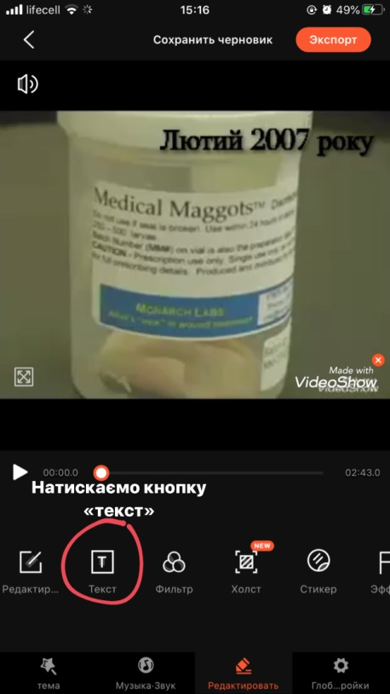
VideoShow video editing application
15 steps strategy:
1-Open the application,
2- Select "Video Editing",
3- Select video file,
4- Select "Text (or Subtitle)"
mode:

Slide 17
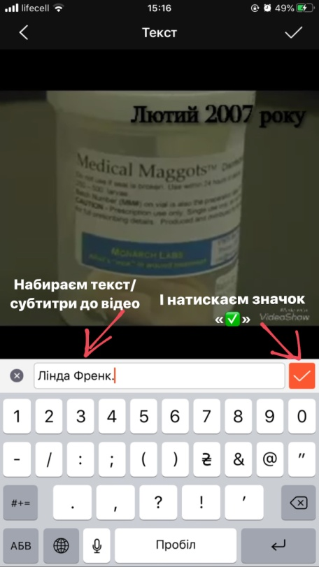
VideoShow video editing application
5- Start adding subtitle
by pressing (+),
6- Type text:

Slide 18
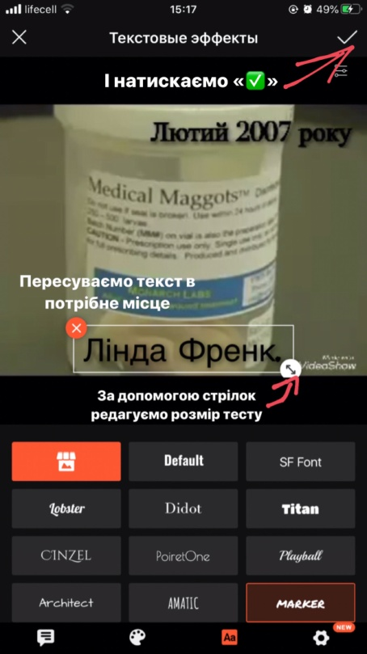
VideoShow video editing application
7- Add text effects,
8- Choose text color,
9- Select "Font" mode,
10- Choose font,
11- Put text on a
desired location:

Slide 19
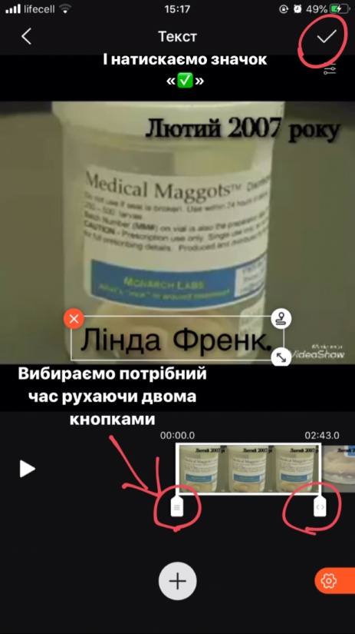
VideoShow video editing application
12- Define a time of
subtitle display:
Steps 4-12 need to be repeated
to form all the subtitles of
the video, taking into account
the subtitle timing

Slide 20
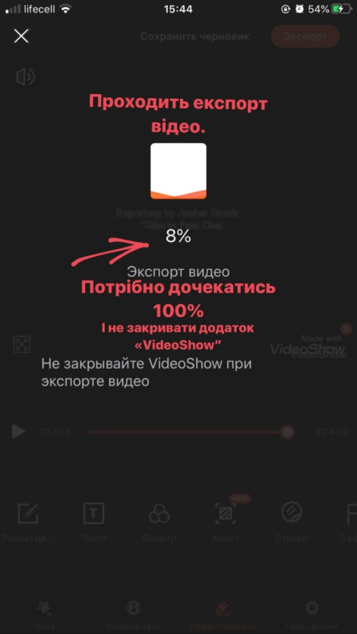
VideoShow video editing application
13- Export of the video file,
14- Save video.
15- Progress of export

Slide 21
Conclusions
Up to 80% of the text is displayed correctly
The lowest input error rate is provided by Google Translate service (1.68%) and Speech Texter application (2.36%)
While choosing a tool the availability of Internet access should be taken into account
Voice input is a useful supplement to the assistance of a sign language interpreter which is the traditional form of learning support for deaf students

Slide 22
Conclusions
Creating subtitles with VideoShow may seem like a time-consuming process compared to YouTube automatic mode, but VideoShow allows editing the content of subtitles, that is often necessary when developing educational videos.
Information technology tools in combination with traditional methods of organizing the educational process ensure a more complete implementation of the inclusive education model for deaf students

